Slide 1
New OHSEP Directors’ Orientation
2024 Louisiana Emergency Management Conference
“By Failing to Prepare, You Are Preparing to Fail ”
~ Benjamin Franklin

Slide 2
Training Agenda
Opening Comments – Director Jacques Thibodeaux
Introductions of New Parish Directors and Deputy Directors
Division/Section Briefings and Introduction
  Regional Support Coordination
  Emergency Management Division
  Security & Interoperability Division
  Public Assistance Division
  Individual Assistance Section
  Hazard Mitigation Division
  Security & Interoperability Division
Q & A

Slide 3

New Organizational Structure and
Senior Leadership Titles
GOHSEP Director & GOHSEP Deputy Director
Confidential Assistant
Business Liaison
GOHSEP Five Assistant Directors
  Assistant Director- Emergency Management
  Assistant Director- Financial Operations & Administration
  Assistant Director- Hazard Mitigation
  Assistant Director- Public Assistance
  Assistant Director- Security and Interoperability
GOHSEP Regional Structure
Director- Regional Support Operations
Three Area Directors
Nine Regional Coordinators

Slide 4
GOHSEP Vision: Serve as an extension of the Office of the Governor and provide sound leadership
GOHSEP Mission: Utilize three priorities to save lives, protect property and maintain infrastructure:
Priority Number One: GOHSEP serves as the emergency arm of the Governor
Priority Number Two: Ensure Agencies have a voice and an agency to champion for them
Priority Number Three: Review internal best business practices and potential for improvements
GOHSEP Goals:
Apply leadership directly towards lifesaving, protect public/private property and protect, operate and improve our infrastructure
Quickly and efficiently move resources through the emergency management cycle
Strategic directive: GOHSEP will be unwavering in our efforts to save lives, protect property and maintain infrastructure
Standardize internal strategic concepts in a specific format to streamline communication

Slide 5
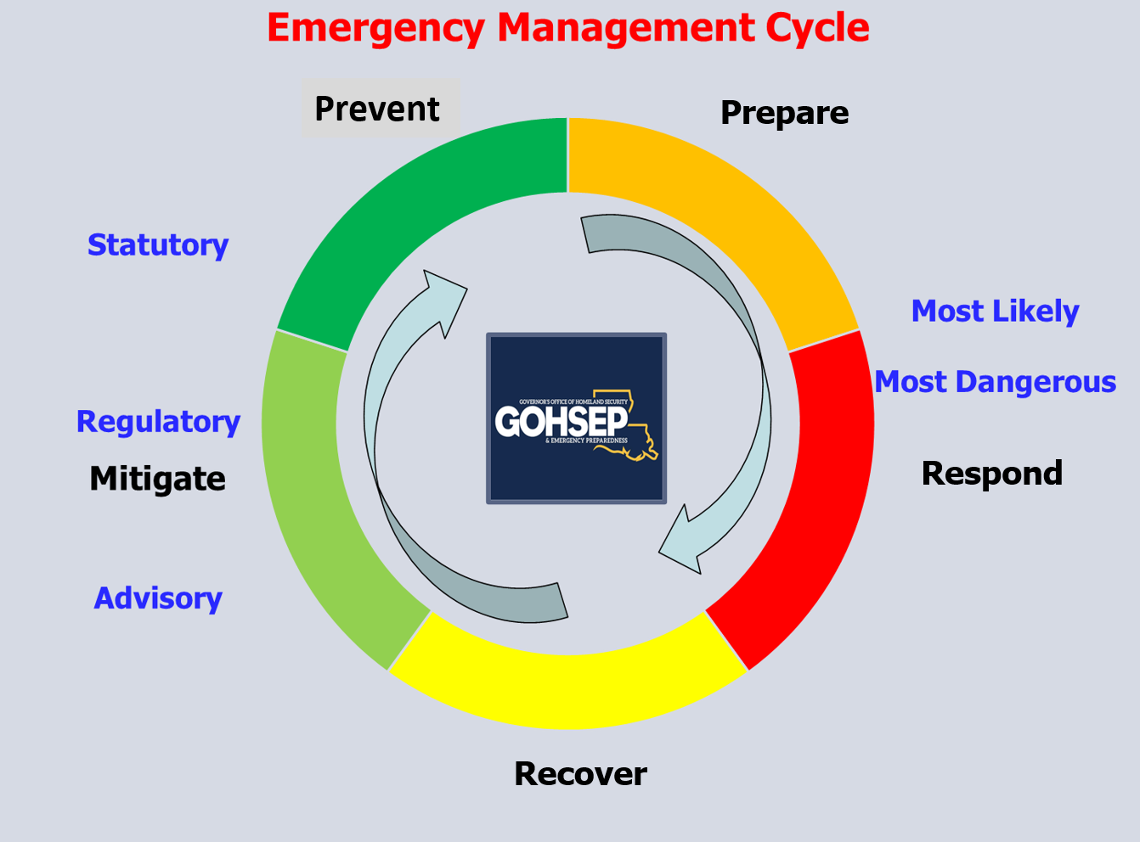

Slide 6
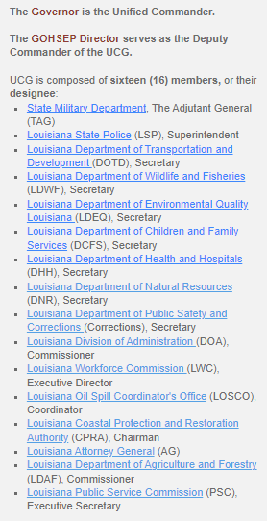
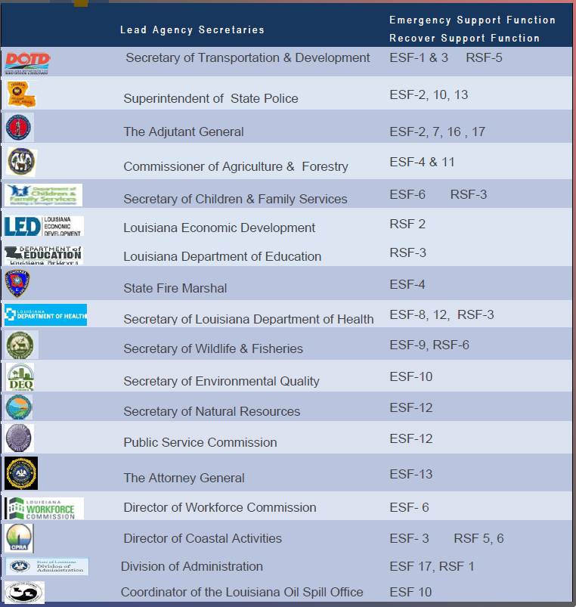
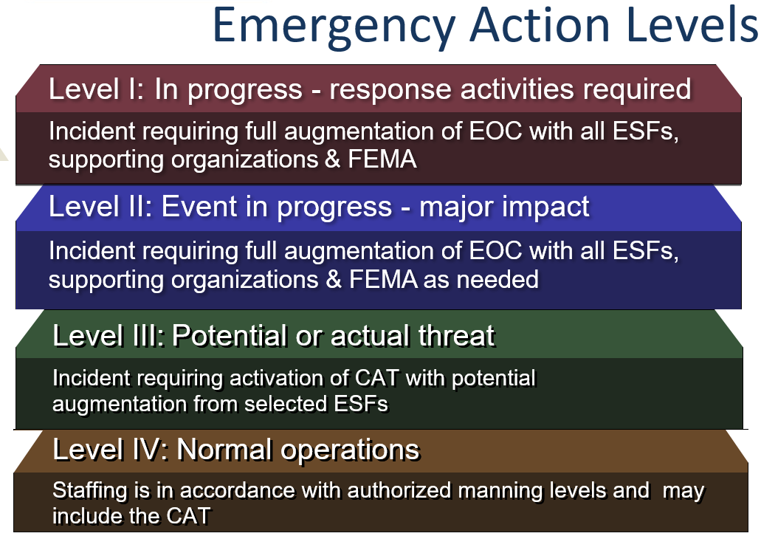
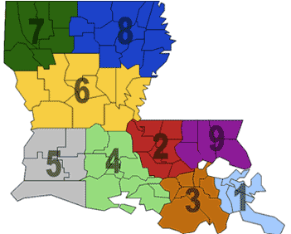
1
2
3
Regional OHSEP Directors Sub-Committee
GOHSEP has designated nine (9) emergency management Regions. The Regional Directors Subcommittee is composed of one (1) Parish Office of Homeland Security and Emergency Preparedness (OHSEP) Director from each Region. Representatives are selected from among their peers and represent their Region. Terms are determined by OHSEP Directors within the Region and terms vary.
The Subcommittee provides a forum where the different Regions collectively discuss homeland security and emergency management issues with each other and the Director of GOHSEP. Members provide a Regional perspective as they offer advice and counsel to Parish or Police Jury Presidents regarding strategic emergency management issues and planning

Slide 7
GOHSEP Org Chart EOC Activation Level IV, Normal Operations
Confidential Assistant
GOHSEP
Director
Louisiana
Business Liaison
Chief Executive Counsel
Director- Regional Support Operations
Confidential
Exec. Assistant
Director-
External Affairs
Deputy
Director
General
Council
Director-
Individual Assistance
Executive
Officer
Director-
Strategic Engagement
Deputy General Council (2)
Quality
Control
Director- Human
Resources
Assistant Director- Financial Operations & Administration
Assistant Director-
Public Assistance
Assistant Director- Emergency Management
Assistant Director-
Security & Interoperability
Assistant Director-
Hazard Mitigation
Executive Officer
Executive Officer
Executive Officer
Executive Officer
Executive Officer
Financial
Services
Facility Management
Grants Management
Applicant Liaisons
Current
Operations
Preparedness& Plans
AI & UAS
Operations
Intelligence
Fusion Center
Applicant Liaisons
Grants Management
Financial
Spt. Services
Sub-Recipient
Monitoring
Closeout
Disaster
Oversight
State
EOC
Future
Plans
GIS
Services
Cyber Operations
Quality
Control
Applicant Closeout
Quality
Control
Quality
Control
Technical Services
Logistics
Support
Community Preparation
Inter-Operability
School
Safety
Technical Services
Training & Exercises
Non-Disaster Ops Grants
Critical Infrastructure
& Nuclear Facilities
HM
Planning
- - - A coordination line is a formal organizational relationship to allow departments to operate in support of each other.
Training Programs

Slide 8
GOHSEP Org Chart EOC Activation Level IV, Normal Operations
Confidential Assistant (LEPA)
GOHSEP
Director
Louisiana
Business Liaison/LBEOC
Director- Regional Support Operations
Deputy
Director
GOHSEP Regional Structure
Director- Regional Support Operations
Three Area Directors
Nine Regional Coordinators
Regional OHSEP Directors Sub-Committee
GOHSEP has designated nine (9) emergency management Regions. The Regional Directors Subcommittee is composed of one (1) Parish Office of Homeland Security and Emergency Preparedness (OHSEP) Director from each Region. Representatives are selected from among their peers and represent their Region. Terms are determined by OHSEP Directors within the Region and terms vary.
The Subcommittee provides a forum where the different Regions collectively discuss homeland security and emergency management issues with each other and the Director of GOHSEP. Members provide a Regional perspective as they offer advice and counsel to Parish or Police Jury Presidents regarding strategic emergency management issues and planning

Slide 9
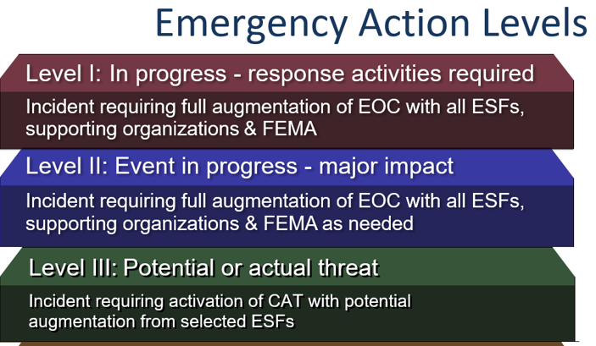
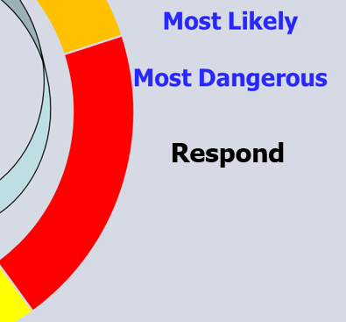
GOHSEP Org Chart EOC Activation Level III,II,I
Parish
OEP Team
GOHSEP
Executive Team
GOHSEP
Business Team
Parish
OEP Team
GOHSEP
Executive Team
GOHSEP
Legal Team
GOHSEP
Executive Team
GOHSEP
External Affairs Team
GOHSEP
IA TEAM
GOHSEP
FEMA LNO
GOHSEP
Employee HR
GOHSEP GA
Finance & Admin Team
GOHSEP PA
PDA & EMAC Team
GOHSEP EM
EM Team
GOHSEP SI UCG,
Interoperability & Intel Team
GOHSEP HM
Logistics Team
Executive Officer
Executive Officer
Executive Officer
Executive Officer
Executive Officer
Recovery- Grants
Facility Services
Grants Management
Applicant Liaisons
Current
Operations
Preparedness& Plans
AI and UAS
Operations
Intelligence
Fusion Center
Quality
Control
Grants Management
State Management
Admin Services
Applicant Closeout
Disaster
Oversight
State
EOC
Future
Plans
GIS
Services
Cyber Operations
Applicant Liaisons
Applicant Closeout
Sub-Recipients
Homeland Sec. Grants
Quality
Control
Technical Services
Logistics
Support
Community Preparation
Inter-Operability
School
Safety
Technical Services
Quality
Control
Site Inspections
Training & Exercises
Non-Disaster Ops Grants
Critical Infrastructure
& Nuclear Facilities
HM
Planning
Training Programs

Slide 10







Linking Emergency Management
Via the Private Sector
To Law Enforcement

Slide 11
Mission essential tasks have countless sub tasks that are classified as specified tasks(what leaders are directed to do) and implied tasks (what leaders sense needs to be done) to support strategic change. This document lists mission essential tasks only. Each mission essential task has an individual strategic action plan that covers the task, purpose, issue, discussion and recommendation for the respective task.
What does strategic change look like?
Key tasks and purposes form mission essential tasks

Slide 12
GOHSEP Strategic Action Plans (SAP)
Vision, mission & goals: Refocus the organization
First 100 Days Concept: Transition in the “first 100 days”
Organizational Restructuring: Restructure the team
Field Visitation Schedule: Get senior leaders in the field
Employee Engagement Program: Improve engagement
90/10% Reimbursement: Expedite reimbursement
Website Redevelopment: Streamline the website
Quality Control Monitor Position: Establish a QC Monitor
30 Day Financial Payments: Expedite payments
QR to Annual Certification: Change an internal policy to help parishes and municipalities
Emergency Hiring Procedures: Modify the hiring process when staffing drops below 85%
Procurement Restructuring: Ensure senior leaders are involved in the process
LABEOC Partnership Expansion: Expand the LABEOC partnership
Cyber Program Restructuring: Reorganize the state cyber program
Emergency Cycle Evolution: Use a most likely and/or most dangerous course of action to determine if a statewide or regional response is required, then act accordingly.
GOHSEP Executive Leadership Program: Provide a central location for agencies to train leaders

Slide 13
Questions
Jacques Thibodeaux 504-915-3120
Federal Fiscal Situation
State Fiscal Situation
GOHSEP Next Steps:
Day 101-180/EMPG-SHSPG/Regional Concepts
2024
For Official Use

Slide 14
Regional Support
Denda Ball, Director

Slide 15
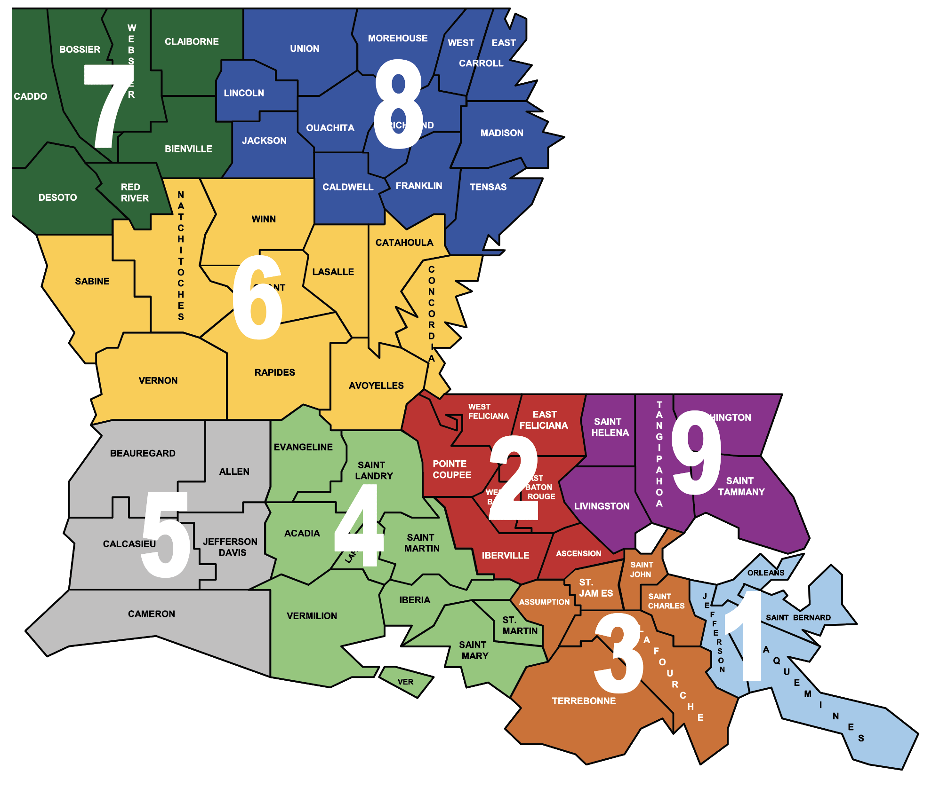
GOHSEP
Emergency Management
Regions
13
Notes:
GOHSEP has divided the State into separate regions to ensure a close-to-the-ground relationship within each Parish. The Regional structure helps to support those efforts.

Slide 16
Regional Support Section
Regional Support Chief
Chief: Denda (Dee) Ball
Phone: (225) 268-6552
Email: Denda.Ball@la.gov
Area Manager
Area Manager
Area Manager
Manager: Margaret (Meg) DeJean
Phone: (225) 329-6000
Email: Margaret.DeJean@la.gov
Manager: Archie Neal Brown
Phone: (318) 376-0687
Email: Neal.Brown@la.gov
Manager: Brandon Migues
Phone: (337) 492-9250
Email: Brandon.Migues2@la.gov
Region 1
Region 6
Region 4
Coordinator: John Gardner
Phone: (504) 615-0128
Email: John.Gardner3@la.gov
Coordinator: Teresa Basco
Phone: (225) 715-3207
Email: Teresa.Basco@la.gov
Coordinator: Darren Guidry
Phone: (225) 614-7050
Email: Darren.Guidry@la.gov
Region 3
Region 7
Region 5
Coordinator: Ashley Beetz
Phone: (985) 316-8950
Email: Ashley.Beetz@la.gov
Coordinator: Todd Derrick
Phone: (318) 510-1460
Email: Todd.Derrick2@la.gov
Coordinator: Amy Michiels
Phone: (337) 842-0659
Email: Amy.Michiels2@la.gov
Region 9
Region 8
Region 2
Coordinator: Matthew Hammons
Phone: (504) 352-4024
Email: Matthew.Hammons@la.gov
Coordinator: Todd Smith
Phone: (318) 237-4817
Email: Todd.Smith@la.gov
Coordinator: Zephna Douglas
Phone: (225) 307-9835
Email: Zephna.Douglas@la.gov

Slide 17
Emergency Management
Mark Ward, Assistant Director
Melton Gaspard, Executive Officer

Slide 18
Plans Section
Provides technical assistance to Parishes
Coordinates State Agency Planning
Revises and Updates the State Emergency Operations Plan
Conducts 16 reviews of Parish Emergency Operations Plans a year.
Oversees the THIRA, SPR, COOP, Annual Report/Capabilities Estimation, SEOP Supplement and NDRF
*All required by State Law La. R. S. 29:726

Slide 19
Plans Section
Annual Report/Capabilities Estimation
Parish EOPs and the Support Analysis Matrix
NIMS Implementation
Supplement 6 Repository
* All documents located in WebEOC

Slide 20


Slide 21
Incident Management
Government Response
Resource Needs
Local Response
Parish Response
Regional Response
(Mutual Aid)
State
Response
Federal
Response
*All emergencies are local and plans must be comprehensive to strengthen capabilities to support the resource needs of all citizens in the community.

Slide 22
Parish OHSEP Annual Requirements
Requirement: Detailed Description: Due Date:
EMPG Quarterly Report: EMPG Quarterly Report includes: Oct. – Dec., due Jan. 15th.
Quarterly Activity; Personnel; Jan. – Mar., due April 15th
Training; Exercise; Equipment; Apr. – Jun., due Jul. 15th
Planning. Jul. – Sep., due Oct. 15th
Pet Plan Details on animal sheltering, veterinary March 1st of each year
medicine, public health and safety,
other professional and technical
personnel deemed appropriate
DHS Data Call National Critical Infrastructure Prioritization March 1st of each year
Program (NCIPP) Data Call Nomination
OHSEP Annual Report Consolidated report of Parish capabilities March 31st of each year
and commodities on hand at parish level

Slide 23
Parish OHSEP Annual Requirements
Requirement: Detailed Description: Due Date:
PEMAC: Form a Parish Emergency Management April 1st each year
Advisory Committee (PEMAC) to offer
advice and counsel to the parish or police
jury president on homeland security and
emergency management issues.
Parish EOP/Update: Shall prepare and maintain an all hazards Due June 30th, every 2 yrs.
emergency operations plan (EOP) and keep it
current. EOP shall be consistent with CPG 101 v.2.
Integrated Preparedness Plan Submit the IPPW sign in sheet to June 30th every year
Workshop (IPPW) GOHSEP via WebEOC.
Special Events National Special Events Data Call, August 1st of each year
covering events from December 1st -
November 30th will be entered in HSIN.

Slide 24
Parish OHSEP Annual Requirements
Requirement: Detailed Description: Due Date:
EMPG/SHSP Grant Acceptance Fed Grant Agreement Articles October 15th – EMPG
October 30th – SHSP
NIMS Implementation: Utilization of standardized resource
management concepts such as typing, October 31st each year
inventorying, and cataloging
RISK Survey/ Assessment Prepare, publish and maintain a November 1st of each year
parish risk assessment
EMPG/SHSP/UASI Project Completed and approved November 30th of each year
Allocation/Applications Project Allocation Forms
Nationwide Cybersecurity annual self- assessment that is designed December 31st of each year
Review (NCSR) to measure gaps and capabilities of state,
local, tribal and territorial (SLTT) governments’
cybersecurity programs.

Slide 25
Important Annual Dates
April 1st - Annual Report Due
June 1^{st -} (Bi-Annual) Parish EOP including Process and Analysis Tool must be uploaded in WebEOC
June 30th- Parish IPPW (formerly known as TEPW) must be conducted.
September 30th - Parish or Region IPP (formerly TEP) must be completed and sent to Training & Exercise.
October 31st - Parish NIMS Implementation board must be updated in WebEOC

Slide 26
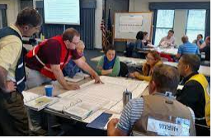
Training and Exercise Section
Coordinates the delivery of all the Homeland Security & Emergency Management training in the state as well as creates Regional and Statewide All Hazards Exercises
Mandated to deliver 80 courses year and participate in at least 5 exercises.
Revises and Updates EMPG requirements for GOHSEP Personnel (EMPG funded personnel are required to participate in 3 exercise per year).

Slide 27
Emergency Management Training
Emergency Management
Examples
Coordinates all emergency management training provided through the Emergency Management Institute (EMI) in Emmitsburg, MD
  Provided in state by EMI certified instructors
  Provided in-person to EMI
ICS- 300 | Intermediate Incident Command System for Expanding Incidents for Operational First Responders
ICS-400 | Advanced Incident Command System
G-386 | Fatalities Management

Slide 28

Homeland Security Training
Homeland Security
Examples
Coordinates training course through the 7 Consortium Partners www.ndpc.us and any Homeland Security Based Training Courses that may have to be funded @ no cost to the jurisdictions
AWR-148 | Crisis Management for School-Based Incidents – Partnering Rural Law Enforcement, First Responders and Local School Systems – Train the Trainer (RDPC)
MGT-319 | Mass Prophylaxis Preparedness and Planning (TEEX)

Slide 29

Available Training Access
Online Registration for Training + Outreach + Events + Exercises
ANNOUNCEMENTS:
We are now accepting training requests for 2022!
Contact gohseptraining@la.gov to schedule your courses.
New training system
Login to STEMS
Register for STEMS
GOHSEP Calendar link is: http://gohsep.la.gov/RESOURCES/TRAINING-EVENTS-SCHEDULE
GOHSEP Registration link is: https://stems.gohsep.la.gov
FEMA Registration link: https://training.fema.gov/
National Training & Education Division: https://www.firstrespondertraining.gov/frts/npccatalog?catalog=EMI

Slide 30
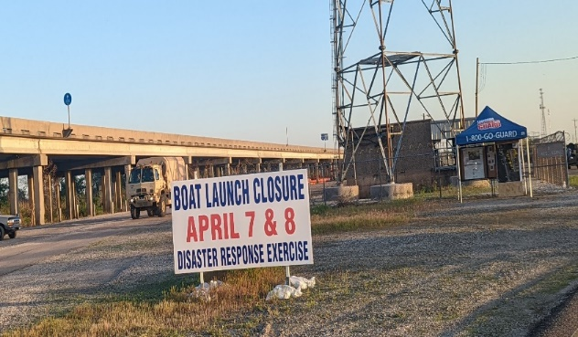
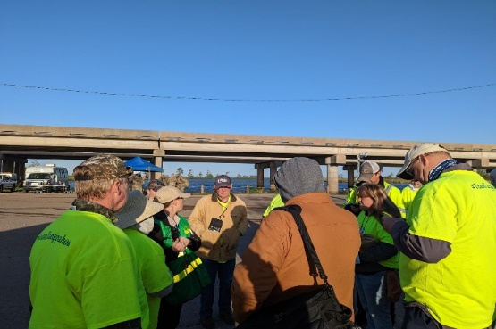
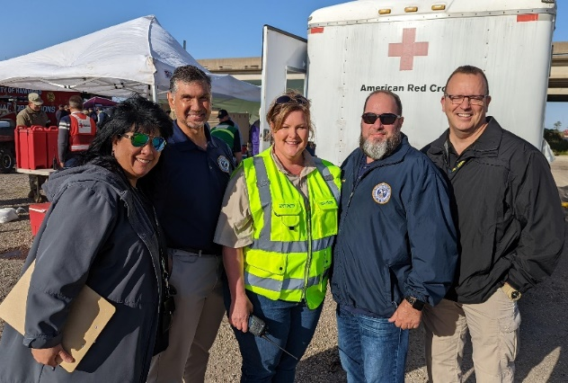

Exercises
Develops, conducts and evaluates exercise on state, regional, and parish level.
Help validate and/or improve state and local agencies plans, policies and procedures to strengthen capabilities for future events
Facilitates the composition of the After Action Review (AAR) for large scale real work events/activations.

Slide 31
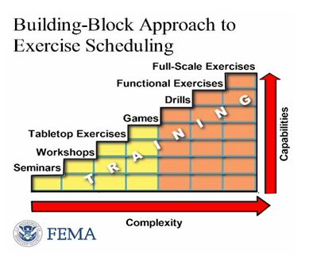
Exercise
GOHSEP follows the Homeland Security Exercise Evaluation Program (HSEEP) http://www.hseep.dhs.gov and uses a building block approach.

Slide 32
State Emergency Operations Center (EOC) Mission Flow
Municipal
Assets
State
Agency
Assets
ESF
Contracts,
Bids, etc.
Contracts,
Bids, etc.
Business
EOC
Municipal:
City/Town/
Village
Parish
EOC
State
Operations
Federal
Assistance
Parish
Assets
Intrastate
Mutual
Aid
EMAC
State
To State
Assets
Contracts,
Bids, etc.
LEGEND
Status Feedback
Request Support
38
Notes:
The diagram on this chart tells us how requests for assistance are made, from whom and to whom. The gray arrows depict requests for support and the gold arrows provide feedback or progress in providing that help or support.
For example, look at the Municipality circle. The Municipality has assets that might be helpful to its own disaster recovery but still needs other help and; therefore, contracts or bids for other services and materials.
Look next at the Parish EOC circle. When local resources are overwhelmed, the Municipality might reach out and submit its request for further assistance to the Parish EOC.
The Parish may be able to help, OR it may need to elevate the request to the State, OR it may be able to reach out for other goods and services through the Intrastate Mutual Aid Compact – also called IMAC.
• IMAC, created by an act of the State Legislature, is an intrastate agreement that enables Parish-to-Parish assistance when a Mutual Aid Agreement (MAA) between Parishes is not already in place.
The State has a host of assistance that it can provide including the Business Emergency Operations Center – or the Business EOC, state agency assets, and assistance through contracts and bids, ESF contracts, EMAC state-to-state assistance and the federal government.
• The Louisiana Business Emergency Operations Center – also known as the LA BEOC – is a partnership between GOHSEP, Louisiana Economic Development – or LED – group and the National Incident Management Systems & Advanced Technologies (NIMSAT) Institute and the University of Louisiana at Lafayette.
• ESFs are contracts made between the State and the federal government through the nation’s Emergency Support Functions. They provide the structure for coordinating Federal interagency support for a Federal response to an incident.
• EMACs are interstate mutual aid compact providing State-to-State assistance and requiring an agreement between States.

Slide 33
Best Practices
Utilize local resources
  Local contracts will be quicker and you have control over when they arrive
  Puts money back into local businesses
  Parishes can get the same reimbursed from FEMA as the State
Coordinate regional assets with neighboring parishes
  Neighbors helping neighbors - IMAC
Once ALL local resources have been exhausted
  Parish submits a declaration of emergency in WebEOC
  Parish enters a WebEOC request to GOHSEP for resources

Slide 34
Best Practices
Utilize local resources
  Local contracts will be quicker and you have control over when they arrive
  Puts money back into local businesses
  Parishes can get the same reimbursed from FEMA as the State
Coordinate regional assets with neighboring parishes
  Neighbors helping neighbors - IMAC
Once ALL local resources have been exhausted
  Parish submits a declaration of emergency in WebEOC
  Parish enters a WebEOC request to GOHSEP for resources

Slide 35
Best Practices
Keep an open line of communication throughout the parish
  The Parish President / Police Jury President
  OHSEP Director
  Sheriff
  Mayor of the municipality
Get to know your local partners during “blue skies”
  Neighboring Parishes
  Local utility companies
  Zoning enforcement
  Businesses….
    Home Depot
    Lowes
    Walmart
    Local “mom and pop” grocery / hardware

Slide 36

WebEOC is the State’s official emergency
management software system.
  WebEOC training is conducted year-round.
  Parish OHSEPs monitor and manage activities
  before, during and after an emergency or disaster.
  WebEOC recently updated to include email notifications sent to Parish Point of Contact (POC) on any change in the mission or tasking.
39
Notes:
These assets are tracked through WebEOC – the State’s official emergency management software system.
WebEOC training is conducted year-round through WebEOC. If you have not already done so, GOHSEP encourages you to identify your responsible employees for requesting resources and schedule them for WebEOC training.
Parish OHSEPs monitor and manage activities through WebEOC before, during and after an emergency or disaster.
WebEOC has been updated to include email notifications sent to Parish Points of Contact – also called POCs – on any change in its mission or tasking.

Slide 37
To learn more about WebEOC, contact:
  The WebEOC Administrator at
  WebEOCAdministrators@la.gov
  Your Parish Office of Homeland Security and Emergency
  Management (OHSEP) https://gohsep.la.gov/about/parishpa
  Request a WebEOC account at https://la.readyop.com/fs/4cdv/1605
  Visit State of Louisiana WebEOC
  WebEOC training at https://gohsep.la.gov/RESOURCES/TRAINING-EVENTS-SCHEDULE
40
Notes:
To learn more contact .. . . (Review the slide).

Slide 38
Public Assistance
Lynne Browning, Assistant Director
Nathan Gary, Executive Officer

Slide 39
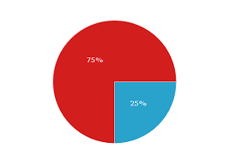
Public Assistance
A Federal reimbursement cost-share program 75% Federal / 25% non-Federal

Slide 40
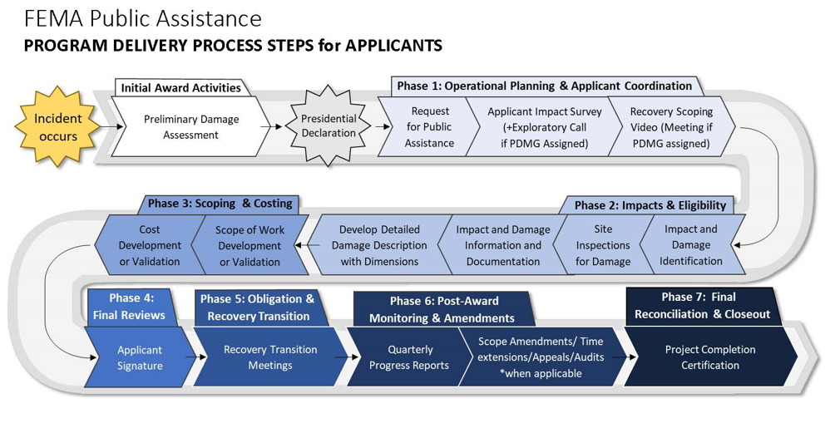
Disaster Life Cycle

Slide 41
Preliminary Damage Assessments
The Preliminary Damage Assessment (PDA) process is a mechanism used to determine the impact and magnitude of damage and resulting needs of individuals, businesses, public sector, and community as a whole. Information collected is used by the State as a basis for the Governor’s request for a major disaster or emergency declaration, and by the President in determining a response to the Governor’s request.

Slide 42
Know what work can be FEMA eligible as you respond
Emergency work consists of debris removal and emergency protective measures.
Result of the declared incident—Pre-disaster photographs and documentation may be needed in support
Within the designated area—Either the damaged facility or the work performed must be within the declaration designated areas (except for sheltering, evacuation, and EOC activities).
Legal Responsibility—Work must be the legal responsibility of the Applicant requesting Assistance. Applicants may need to show jurisdiction or legal authority for any work being claimed

Slide 43
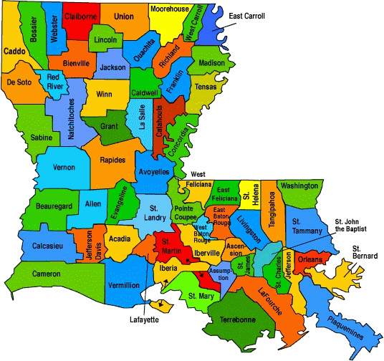
Preliminary Damage Assessments
Getting Federal declaration
  Preliminary damage assessments (PDAs)
    State threshold
      FY24 State Declaration Threshold @ $1.84/Capita = $8,570,272.88
    Parish threshold
      $4.60 per capita (based on 2020 census)

Slide 44
Preliminary Damage Assessments
  Directors role in PDAs:
    WebEOC requests
    Identifying impacted communities and areas
    Sharing information on documenting damages/costs
    Coordination of both State and Federal inspections
      Virtual vs Physical PDAs

Slide 45
Disaster Life Cycle

Slide 46
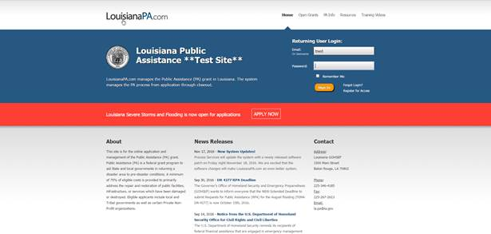
Request for Public Assistance (RPA)

Slide 47
-Public Assistance-
  Who’s eligible for assistance
Cities, Towns, Parishes
Water Districts
State Recognized Tribes
State Agencies
Colleges and Universities
Schools
Non-Profits
  Hospitals
  Volunteer Fire Departments
  Electrical CO-OPS
  Houses of Worship

Slide 48



Now FEMA is involved…
Grants Portal
EC (Exploratory Call)
RSM (Recovery Scoping Meeting
Damages
  Identified within 60 days of RSM

Slide 49
Delivery Model Steps and Phases
PHASE 2
  Applicant, GOHSEP, and PDMG work together to collect necessary information and documentation in order to present project to CRC for review. Normally most time consuming part of delivery model
PHASE 3
  CRC reviews, develops, and validates information in order to send a scope of work ahead for compliance reviews. This includes insurance and mitigation review for any opportunities. Can cause delays if Phase 2 is not completed properly causing project to be returned to previous phase
PHASE 4
  EHP reviews for compliance. Then GOHSEP and Applicant review in order to confirm and accept project
PHASE 5
  Obligation of Project Worksheet. YEA! MONEY!

Slide 50


Streamlined Project Application
Can create own project in Grants Portal
Can be done for Category A&B work and Management Costs (Category Z)
Guidance can be found on Grants Portal under Support (Question Mark at top right); Resources; Applicant Process
Notes:
Show during screen sharing

Slide 51



Project Threshold
Minimum Project is $3,900
Large Project Threshold is $1,037,000

Slide 52

Know the basics
FEMA; DDD; DI; RPA; EEI; SOW; SI; PDMG; TFL; PAGS; IBD; SAL; PS; PRO; PC; GOHSEP; USACE; EHP; MOU; RRF; DUR; SIL; NRCS; SBA; PNP; HOW; MA; IA; FHWA; USFWS; SLTT; PDA; RA; CFR; PAPPG; FMAG; LDAF; DPS; DHS; OIG; LLA; DM; PM; A&E; GC; AD; DD; SC; TL; GL; BC; XO; EO; PIO; RC; AC; RD; VAYGO; PW; CEA; ROW; LPN; EA;

Slide 53
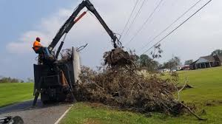
Debris Removal
Make sure your Debris contact is in our database
Develop a DMP NOW (GOHSEP can help)
Pre-positioned contracts should be a part of that plan (GOHSEP Legal can advise on procurement)
For further debris information reach out to:
James “Jim” Richard
James.Richard2@la.gov

Slide 54
Emergency Work
Work Category B
Measures taken before, during, and after a disaster to eliminate/reduce an immediate threat to life, public health or safety, or to eliminate/reduce an immediate threat of significant damage to improved public and private property through cost-effective measures
6 month Completion Deadline from declaration date.

Slide 55
Category B
Emergency Protective Measures
Examples:
  Search and Rescue
  Bracing and shoring levees
  Fire, Police, Medical Services
  Generators
  Sandbagging
  Activation of EOC
  Pumping water, dehumidifying, etc.(GPS Coordinates for pump loc.)
  Sheltering (Congregate and Non-Congregate)

Slide 56
Mosquito Abatement
Put in request in WebEOC following/during disaster
GOHSEP will work with State entomologist to validate health threat
Information that may be needed:
  Evidence of Higher counts
  Evidence of standing water due to flooding
  Increased cases of disease
  Housing damages and/or extended power interruption
  Anticipated duration of cleanup
FEMA only funds increased costs over previous 3 “normal” years of abatement

Slide 57

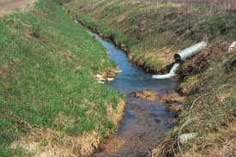


Other FEDERAL Agencies
FHWA (roads)
NRCS (waterway debris removal)
USACE (permits, cost estimate, debris)
SBA (for Private non-profit entities)

Slide 58
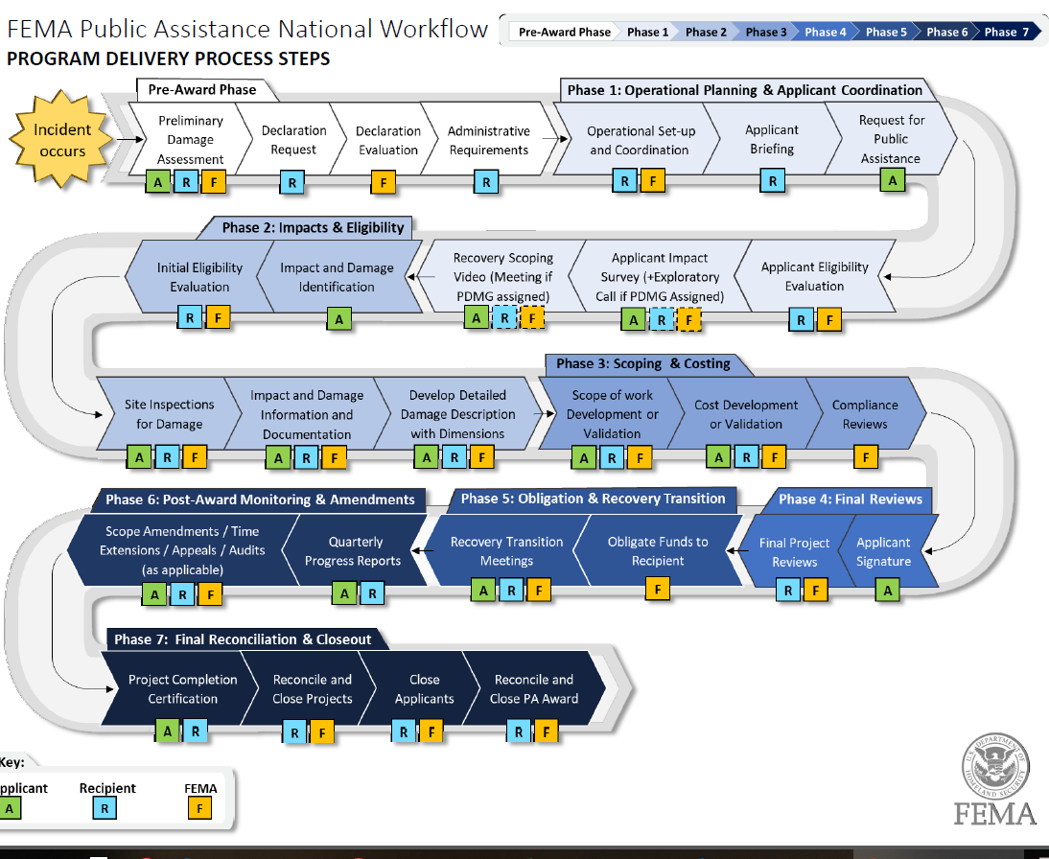

Slide 59
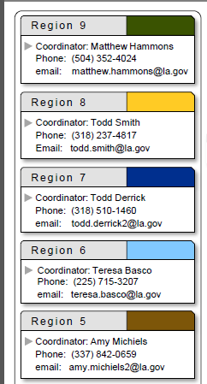
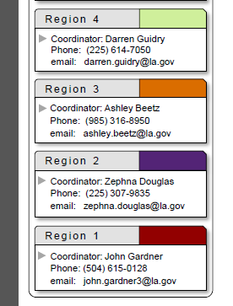
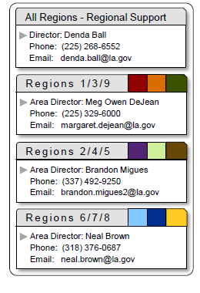
-Public Assistance-
  Primary Contact for GOHSEP
  State Applicant Liaison (SAL)
    PASALS@LA.GOV
    Brittany Humphries Section Chief 225-921-7822
  Regional Coordinators

Slide 60
Helpful E-mails
GOHSEPlegal@LA.Gov - Legal
LA.PA@LA.Gov – LouisianaPA.com
RPA.Help@LA.Gov - RPAs
Debris.Help@La.Gov – Debris
PASALS@la.gov –SAL communication

Slide 61
 | Daniel Crothers | Section Chief Public Assistance Technical Services Governor’s Office of Homeland Security & Emergency Preparedness | GOHSEP Office: 225-932-6371 Mobile: 225-936-5594 Daniel.Crothers@la.gov

Slide 62
Individual Assistance
Overview
Katie M. Underwood, GOHSEP
Individual Assistance Section Chief
7667 Independence Blvd.
Baton Rouge, LA 70806
Direct line: 225-925-7445
Katie.Underwood@la.gov

Slide 63
What Exactly is Individual Assistance?
Resources made available to individuals and households to assist in their recovery from a major disaster
Provides money and services to people in the declared area whose property has been damaged or destroyed and whose losses are not covered by insurance
Also known as “IA”
Individual Assistance Program and Policy Guide (IAPPG) (fema.gov)

Slide 64
Individual Assistance – How and Who
Robert T. Stafford Disaster Relief and Emergency Assistance Act
Federal Declaration
Data Driven Request
Based on Demonstrated Need (no Statutory Threshold)
Federal Disaster Assistance is:
NOT Automatic
NOR Guaranteed
All Louisiana citizens must plan comprehensively.

Slide 65
Small Business Association (SBA)
The SBA may provide low-interest, long-term loans to help eligible applicants with transportation losses, as well as repair/replacement funds for real and personal property damage caused by the disaster.
An SBA administrative declaration may be possible even when FEMA Individual Assistance is not. There are set thresholds for an administrative SBA declaration:
25 major or destroyed (greater than 40%) uninsured properties
Disaster Loan Outreach Centers are established when there is a SBA administrative declaration.

Slide 66
Project analysis slide 3
PDA Process
Local/Parish Collects Data on Damages
Local/Parish Damage Assessment
Parish Request IA PDA
Joint Parish and GOHSEP PDA for IA
Review of Preliminary Findings
Information collected by local/parish should be provided to GOHSEP. If damages are consider major and destroyed, parish can request IA PDA through WebEOC.
Local/parish teams made up of non-emergency management office staff are trained to collect damage information.
Local/parish assessment teams complete surveys in the community to account for damages reported..
Parish and GOHSEP will coordinate Joint PDA where Parish escorts and takes the IA PDA team to review damages reported.
All data completed by the Joint IA PDA Team will be reviewed to determine if data warrants an IA Declaration.
Damage.la.gov

Slide 67

Project analysis slide 2
Initial Damage Assessment
Address & Contact Information
Damage Description
Ownership: Own/Rent
Resident
Insurance Coverage
Dwelling Type: Single Family,
Multi-Family, Manufactured Home
Specify levels of damage
If flood, state water depth in inches.
Affected- Indicate the number of structures with cosmetic damage to structure. Still livable.
Minor Damage-Indicate the number of structures with minor damage. Minor damages require minimal repairs to roofs, doors, windows, floors, utilities etc. Generally, minor damage structures are habitable and repairable within 30 days.
Major Damage -Indicate the number of structure with major damage. Major damage is defined as physical damages that make the impacted structures uninhabitable, but repairable. Extensive damage to the foundation, roof and walls of the home.
Destroyed- Indicate the number of each structures classified as destroyed. Destroyed is defined as those structures that have been made uninhabitable because of disaster or incident.

Slide 68
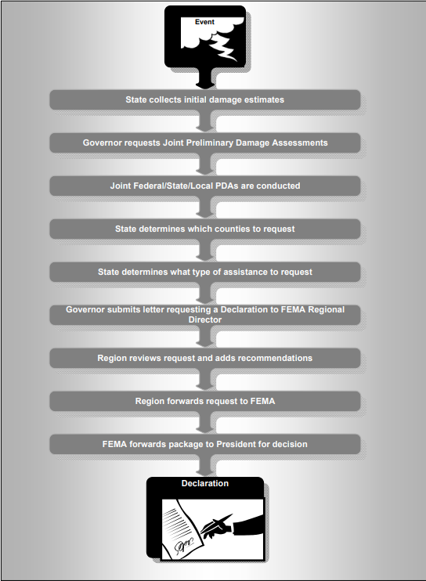

Slide 69
Federal IA Declaration
Once a federal declaration is granted for IA, individuals and families in the designated parishes can apply:
Online at DisasterAssistance.gov
Use the FEMA mobile app.
Call FEMA at 800-621-3362 (TTY – 800-462-7585) 24 hours a day, seven days a week. Multilingual operators are available.
Temporary FEMA Disaster Recovery Centers (DRCs) which may open in affected parishes.
Registration period is typically 60 days from date of declaration.

Slide 70
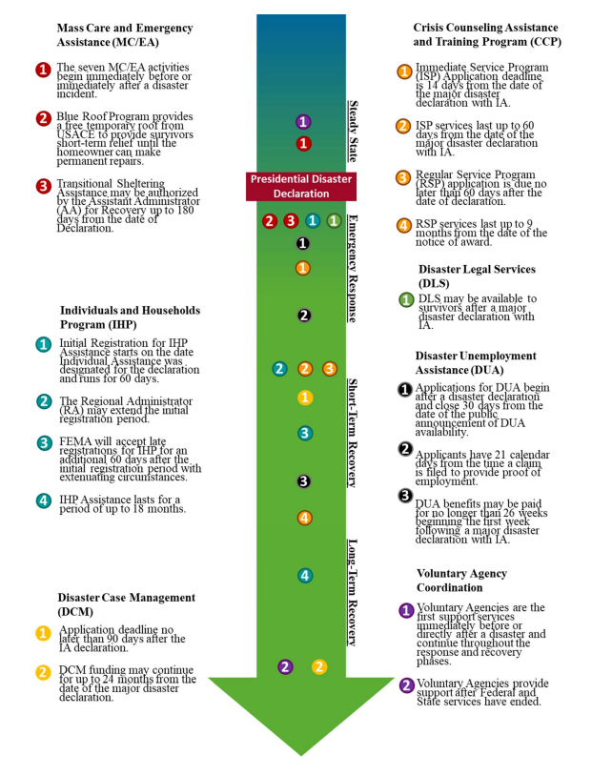
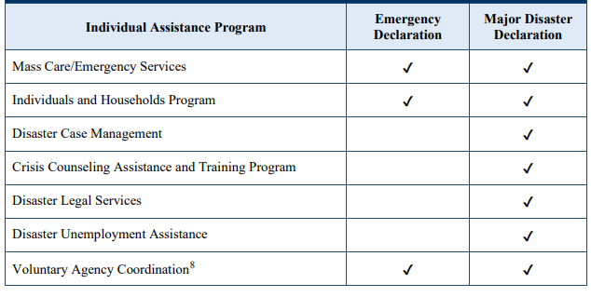
Individual Assistance Programs

Slide 71
Housing Assistance (HA)
FINANCIAL HOUSING ASSISTANCE
FEMA provides funds paid directly to eligible individuals and households and may include the following types of assistance:
Rental Assistance
Lodging Expense Reimbursement
Home Repair/Replacement Assistance
Funds paid to individuals counts toward the maximum amount of financial assistance an applicant may receive.
DIRECT HOUSING ASSISTANCE
FEMA may provide Direct Housing Assistance when eligible applicants are unable to use Rental Assistance due to a lack of available housing resources. Direct Housing Assistance is not subject to a financial maximum award limit. Types of Direct Housing Assistance may include:
Multi-Family Lease and Repair
Transportable Temporary Housing Units (MHU/TTU)
Direct Lease

Slide 72
Other Needs Assistance (ONA)
Applicants may receive financial assistance for other disaster-caused necessary expenses and serious needs.
Serious Needs Assistance
Displacement Assistance
Personal Property Assistance
Transportation Assistance
Group Flood Insurance Policy
Funeral, Medical, Dental Assistance
Child Care Assistance
Assistance for Miscellaneous Items (chainsaws and generators)
Moving and Storage, Clean and Sanitize Assistance
Financial assistance awarded for ONA counts toward the maximum amount of financial assistance an applicant may receive.

Slide 73
Hazard Mitigation
Sandra Gaspard, Assistant Director
Jeffery Giering, Executive Officer

Slide 74
Hazard Mitigation Assistance Division
Assistant Director Sandra Gaspard
Executive Officer Jeffrey Giering
Tech Services (Vacant)
Grants Management Byron Brooks
Closeout Anne Day
State Applicant Liaisons Lakeivea Blanco

Slide 75
Hazard Mitigation Assistance
What is Hazard Mitigation?
  Any sustained action taken to reduce or eliminate long-term risks to people and property from natural hazards and their effects
  Examples: Elevate, Reconstruct or acquire flood-prone properties, safe room construction, localized drainage improvements, redundant power for critical facilities (generators)

Slide 76

Hazard Mitigation Assistance
6
Source: National Institute of Building Sciences, 2017 Mitigation Saves Interim Report

Slide 77
Hazard Mitigation Assistance
Pre-Mitigation

Slide 78
Hazard Mitigation Assistance
Post Mitigation

Slide 79
Hazard Mitigation Assistance
When is funding available?
  Hazard Mitigation Grant Program (HMGP)
    Federally declared event
  Flood Mitigation Assistance
    Annual grant program
  Building Resilient Infrastructure and Communities
    Annual grant program

Slide 80



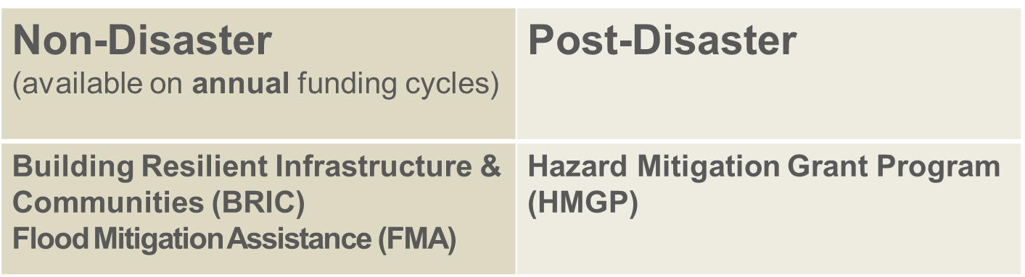
Hazard Mitigation Assistance

Slide 81
Hazard Mitigation Grant Program
Section 404 of the Stafford Act, or the “HMGP,” includes Post-Fire
Post-disaster grant made available after a Presidentially-declared disaster authorized by the Stafford Act
  Seven (7) disasters in 2020-2021 resulted in HMGP funding of $1.1B to the State
  Over 350 subapplications submitted
Allocated to a parish based on Public Assistance permanent work/Individual Assistance funding
Can be used to mitigate all threats/hazards
FEMA covers up to 75% of eligible project costs
Period of Performance 48 months from application period close

Slide 82
Hazard Mitigation Grant Program (HMGP)
Hazard Mitigation Grant Program provides funding to state, local, tribal and territorial governments so they can develop hazard mitigation plans and rebuild in a way that reduces, or mitigates, future disaster losses in their communities. This grant funding is available after a presidentially declared disaster.
In this program, homeowners and businesses cannot apply for a grant. However, a local community may apply for funding on their behalf.
All state, local, tribal and territorial governments must develop and adopt hazard mitigation plans to receive funding for hazard mitigation project application.
Cont…Non Disaster Grant (competitive) Opportunities.

Slide 83
Flood Mitigation Assistance Program (FMA)
Annual, nationally competitive grant program
  Projects must benefit the National Flood Insurance Program (NFIP)
Projects selected based on FEMA priorities – Notice of Funding Opportunity (NOFO)
Can be used to mitigate only flood-related hazards/impacts
Structures must be NFIP insured at the time the application period opens
FEMA provides between 75% and 100% of project costs (SRL & RL )
Period of Performance 36 – 48 months from date of award

Slide 84
FY23 FMA Info
Eligible
Applicants
State, Local, Tribal Governments
Homeowners must apply through an eligible local government
$800M available in total program funding
$60M available for capability and capacity building activities
$220M available for individual flood mitigation projects
$520M available for localized flood risk mitigation projects
Expect to make 40 awards and up to 725 sub awards
Available
Funding
Capability and Capacity-Building Activities that develop future projects that reduce flood claims against NFIP
Localized Flood Risk Reduction Projects that address community flood risk
Individual Flood Mitigation Projects to mitigate the risk of flooding to individual NFIP insured structures.
Eligible
Activities
Applications were due to GOHSEP 1/29/2024
Applications were due to FEMA 2/29/2024
36-month period of performance
Timeline

Slide 85
Building Resilient Communities & Infrastructure (BRIC)
FEMA grant program launched four years ago
Annual, nationally competitive grant program
  Funding comes from 6% set aside of Disaster Relief Fund
Projects selected based on FEMA priorities – Notice of Funding Opportunity (NOFO)
Projects rated through an evaluation of both their technical and qualitative criteria during National Technical Review
FEMA covers up to 75% of project costs
Period of Performance 36 months from date of award

Slide 86
FY23 BRIC INFO
State, Local, Tribal Governments
Local governments are eligible as sub-applicants and must submit through GOHSEP.
Eligible
Applicants
Available
Funding
$1B available in total program funding.
$701M for the National Competition, with a maximum award of $50M
25% non-federal cost match.
Capability and Capacity-Building Activities (examples include improving building codes, project scoping, hazard mitigation and planning related activities)
Hazard Mitigation Projects (funds available to support projects aimed to allow communities to become more resilient and increase public safety)
Eligible
Activities
Applications were due to GOHSEP 1/29/2024
Applications were due to FEMA 2/29/2024
36-month period of performance
Timeline

Slide 87
FY23 BRIC and FMA Submissions
Program | Count of Subapplications | Federal Dollars Requested
BRIC | 48 | $527,428,561
FMA | 44 | $471,435,239
Total | 92 | $998,863,800

Slide 88
BRIC vs FMA Project Types
BRIC
Objective: to reduce the risk of natural disasters and build stronger, more resilient infrastructure.
BRIC is best for the following projects:
  Multi-benefit and multi-hazard projects
  Projects that support more than one community and demonstrate collaboration (e.g., drainage, utilities, watershed)
  Resilience-focused projects
  Nature-based projects
FMA
Objective: to reduce or eliminate long-term flood risk, emphasizing measures that benefit the National Flood Insurance Program (NFIP).
FMA is best for the following projects:
  Projects that benefit the NFIP such as property acquisitions and elevations.
  Community drainage projects

Slide 89
Other Hazard Mitigation Assistance Programs
SWIFT Flood Mitigation Assistance (SWIFT FMA)
  $40M awarded to Louisiana in FY22 (inaugural year)
  Louisiana is currently ineligible for FY23 funding (requires major flood declaration prior to May 2024)
Safeguarding Tomorrow through Ongoing Risk Mitigation (STORM Act) Revolving Loan Fund (RLF)
  FEMA provides capitalization grants to eligible Applicants to establish revolving loan funds that provide low interest loans to local governments for projects that mitigate impacts from natural hazards.
L-PDM: Congressionally Directed Spending; project proposals submitted to local Senator’s office for consideration

Slide 90
Primary Components of all Applications
Scope of Work (SOW)
Cost Estimate
Budget Narrative
Property index
Photos/Maps of proposed project site
Benefit Cost Analysis (BCA)
Project Schedule
  (with milestones)
Funds Commitment letter for the local share

Slide 91
Hazard Mitigation Assistance
Benefit Cost Analysis
  Required for most HMA projects
  Technical component that may require use of a professional
  Determines if a project is cost-effective
    If not, project denied
  Benefit Cost Ratio (BCR) =
      $ Benefits / $ Total Costs
Project Costs
Project Benefits

Slide 92
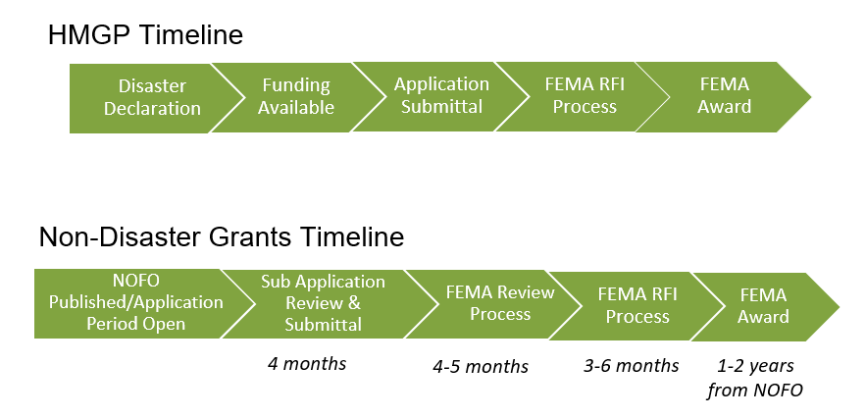
Hazard Mitigation Assistance

Slide 93
Hazard Mitigation Assistance
Local Roles in applying for funding
  Awareness of open application periods
  Identify all mitigation priorities and opportunities with local stakeholders
    homeowners must submit through a local jurisdiction or parish
  Subapplications entered into GOHSEPGrants.la.gov for HMGP and into FEMA GO for non-disaster
  Complete subapplications detail the who, what, when, why, where, and how much for all projects
  Work cannot begin until receiving FEMA approval

Slide 94
Hazard Mitigation Assistance
Local Roles in getting reimbursement
  Subawards (grants) paid on cost-reimbursement basis
  Submit request for reimbursement (RRF) package
    RRF form and summary records
    Procurement documentation
    Other pertinent support documentation
  Respond to Requests for Information (RFIs)/corrections
  Quarterly progress reports
  Time Extensions
    Timely submission to GOHSEP
    Updated milestones and completion timelines

Slide 95
Hazard Mitigation Assistance
  Other Local Roles
    Ensuring local hazard mitigation plan is current and updated every 5 years (required to receive funding)
    Coordinating ongoing education/technical assistance needs
    Elevating issues through RC/HMA management
    Identifying program management needs within parish
      State contract available to build local capacity 2021 - present

Slide 96
Hazard Mitigation Plan-Program Requirements
Approved and adopted mitigation plans are a requirement for local governments, including special districts, to be eligible for grant funding from the following FEMA programs:
Hazard Mitigation Grant Program (HMGP)
Building Resilient Infrastructure and Communities (BRIC)
Flood Mitigation Assistance (FMA)
Pre-Disaster Mitigation Grant Program (PDM)
Fire Management Assistance Grant Program (FMAG)
Safeguarding Tomorrow Revolving Loan Fund Program (RLF)

Slide 97
Hazard Mitigation Plans Status Map
W
W
8
E
MOREHOUSE
E
CLAIBORNE
UNION
EAST
4 parishes under revision/update
9 parishes are APA – final adoptions
53 parishes approved
State of LA plan is Approved 3/20/24
BOSSIER
UNION
BOSSIER
B
B
WEST
S
S
8
T
7
T
CARROLL
E
E
LINCOLN
R
LINCOLN
CADDO
R
CADDO
RICHLAND
OUACHITA
RICHLAND
OUACHITA
MADISON
JACKSON
MADISON
BIENVILLE
JACKSON
RED
FRANKLIN
RED
N
DESOTO
N
DESOTO
RIVER
RIVER
A
CALDWELL
A
WINN
TENSAS
T
T
C
C
H
H
CATAHOULA
I
CATAHOULA
I
T
T
6
C
LASALLE
C
O
LASALLE
O
O
SABINE
O
SABINE
C
C
GRANT
GRANT
N
H
N
H
C
E
C
E
O
S
O
S
R
R
D
D
I
I
A
RAPIDES
A
VERNON
RAPIDES
AVOYELLES
VERNON
WEST
T
WEST
EAST
9
EAST
A
FELICIANA
A
FELICIANA
WASHINGTON
SAINT
WASHINGTON
FELICIANA
SAINT
FELICIANA
N
2
HELENA
N
HELENA
G
EVANGELINE
G
5
EVANGELINE
I
BEAUREGARD
I
BEAUREGARD
P
POINTE
P
SAINT
POINTE
SAINT
A
ALLEN
A
ALLEN
COUPEE
LANDRY
COUPEE
LANDRY
EBR
H
H
SAINT
SAINT
TAMMANY
O
TAMMANY
WEST
O
WEST
BATON
BATON
A
ROUGE
LIVINGSTON
A
ACADIA
4
ROUGE
LAFAYETTE
JEFFERSON
LAFAYETTE
SAINT
JEFFERSON
IBERVILLE
DAVIS
CALCASIEU
DAVIS
MARTIN
ASCENSION
SAINT
SAINT
ORLEANS
JOHN
ORLEANS
ST.
JOHN
ST.
1
JAM ES
JAM ES
J
SAINT
J
IBERIA
SAINT
IBERIA
ASSUMPTION
3
ASSUMPTION
E
CHARLES
E
CAMERON
CHARLES
CAMERON
F
VERMILION
F
VERMILION
SAINT BERNARD
ST.
SAINT BERNARD
ST.
F
F
P
L
P
MARTIN
L
MARTIN
E
E
L
A
L
A
R
SAINT
R
SAINT
A
F
A
F
S
MARY
S
MARY
Q
O
Q
O
O
O
N
N
U
U
U
U
E
VER
E
VER
R
R
M
C
M
TERREBONNE
C
TERREBONNE
I
H
I
H
N
E
N
E
E
E
S
S

Slide 98
Options to Update Plan
GOHSEP/SDMI – partnership turnkey plan update
  GOHSEP manages contract, assists you in managing the update process
  No cost share to locals
  You have the ability to provide input and direction
Grant assistance – parish applies for own project
  Contract procured and managed locally
  Non federal cost share of 25%, based on grant cost share requirements
  GOHSEP provides guidance and assistance, but majority of work is done at the local level

Slide 99
Hazard Mitigation SAL Map
Region 7
HM SAL – La’Keilla Veal
LaKeilla.Veal2@la.gov
Cell: 318.237.8333
Region 8
HM SAL – Christopher Olvey
Christopher.Olvey2@la.gov
Cell: 318.237.8333
W
8
W
MOREHOUSE
E
E
CLAIBORNE
UNION
EAST
BOSSIER
UNION
BOSSIER
B
B
WEST
S
S
8
T
7
T
CARROLL
E
E
LINCOLN
R
LINCOLN
CADDO
R
Region 6
HM SAL – Roland Spano
Roland.Spano@la.gov
Cell: 225.337.0139
CADDO
RICHLAND
OUACHITA
RICHLAND
Region 2
HM SAL – Brian McGovern
Brian.Mcgovern@la.gov
Cell: 347.645.6714
(East Baton Rouge, Livingston only)
HM SAL – DeVonne Campbell
DeVonne.Campbell2@la.gov
(Remaining R2 Parishes)
Cell: 225.266.8626
OUACHITA
MADISON
JACKSON
MADISON
BIENVILLE
JACKSON
RED
FRANKLIN
RED
N
DESOTO
N
DESOTO
RIVER
RIVER
A
CALDWELL
A
TENSAS
T
T
WINN
C
WINN
C
H
H
CATAHOULA
I
CATAHOULA
I
T
Region 4
HM SAL Christopher Olvey
Christopher.Olvey2@la.gov
Cell: 318.237.8333
T
6
C
LASALLE
C
O
LASALLE
O
O
SABINE
O
SABINE
C
C
GRANT
GRANT
N
H
N
H
C
E
C
E
O
S
O
S
R
R
D
D
I
I
A
RAPIDES
A
VERNON
RAPIDES
VERNON
AVOYELLES
AVOYELLES
WEST
T
Region 9
HM SAL – Kristal Craig
Kristal.Craig@la.gov
Cell: 504.495.2126
Region 5 (except Calcasieu)
HM SAL –Charlene Christophe-Scott
Charlene.Christophe@iem.com
Cell: 225.620.7992
WEST
EAST
9
EAST
A
FELICIANA
A
FELICIANA
WASHINGTON
SAINT
WASHINGTON
FELICIANA
SAINT
FELICIANA
N
2
HELENA
N
HELENA
G
EVANGELINE
G
5
EVANGELINE
I
BEAUREGARD
I
BEAUREGARD
P
POINTE
P
SAINT
POINTE
SAINT
A
ALLEN
A
ALLEN
COUPEE
LANDRY
COUPEE
LANDRY
EAST
H
H
SAINT
WBR
BATON
SAINT
TAMMANY
O
TAMMANY
WEST
O
WEST
ROUGE
BATON
BATON
A
ROUGE
EBR
LIVINGSTON
A
ACADIA
4
ROUGE
LAFAYETTE
ACADIA
LAFAYETTE
SAINT
JEFFERSON
SAINT
CALCASIEU
JEFFERSON
CALCASIEU
DAVIS
MARTIN
IBERVILLE
DAVIS
ASCENSION
MARTIN
IBERVILLE
ASCENSION
SAINT
Region 1
HM SAL – Steve Pratt
Steve.Pratt@iem.com
Cell: 225.303.6550
Calcasieu
HM-SAL – Claudia Kirtikar
Claudia.Kirtikar@la.gov
Cell: 225.939.7228
SAINT
ORLEANS
JOHN
ORLEANS
ST.
JOHN
ST.
1
JAM ES
JAM ES
J
SAINT
J
IBERIA
SAINT
IBERIA
3
ASSUMPTION
ASSUMPTION
E
E
CHARLES
CAMERON
CHARLES
CAMERON
F
VERMILION
F
VERMILION
SAINT BERNARD
ST.
SAINT BERNARD
ST.
F
F
P
L
P
MARTIN
L
MARTIN
E
E
L
A
L
A
R
SAINT
R
SAINT
A
F
A
F
S
MARY
S
MARY
Q
O
Q
O
O
O
N
N
U
U
U
U
E
VER
E
VER
R
R
M
C
M
TERREBONNE
C
TERREBONNE
I
H
I
H
N
E
N
Terrebonne
HM-SAL – Elba Meador
Elba.CintronMeador@iem.com
Cell: 407.463.5377
E
E
Region 3 (except Terrebonne)
HM-SAL – La’Keilla Veal
LaKeilla.Veal2@la.gov
Cell: 318.237.8333
E
S
S
SAL Section Chief– LaKeivea Warren Blanco
Lakeivea.Blanco@la.gov
Cell: 225.324.6073
Regions 1, 4,5,7 and 8
HM SAL TL– Stanley Aaron
Stanley.Aaron@la.gov
Cell: 225.907.0483
Regions 2,3,6,9 and State Agencies
HM SAL TL– Heather Ewing
Heather.Ewing@la.gov
Cell: 225.226.5482

Slide 100
Hazard Mitigation Assistance Contacts
Sandra Dugas Gaspard Jeffrey Giering
Assistant Director Executive Officer
985-969-0410 225-932-6300
Sandra.Dugas@la.gov Jeffrey.Giering@la.gov
(Vacant) Byron Brooks
Section Chief--Technical Services Section Chief – Grants Management
225-932-6285
Byron.Brooks@la.gov
LaKeivea Warren Blanco Anne Day
Section Chief – State Applicant Liaisons Section Chief - Closeout
225-932-6292 225-932-6267
LaKeivea.Blanco@la.gov Anne.Day@la.gov

Slide 101
Security & Interoperability
Euclid Talley, Assistant Director
Thomas Mule, Executive Officer

Slide 102
Critical Infrastructure Protection
Noel Bellas- Section Chief
Jacie Maples- Specialist

Slide 103
Responsibilities of CI
Review and influence the Metropolitan Statistical Area (MSA) and Urban Area Security Initiative (UASI) Risk Profiles which dictates funding for:
  State Homeland Security Program (SHSP) $4,847,500 FY 23
  Urban Area Security Initiative (UASI) $1,645,333 FY 23
  Operation Stonegarden (OPSG) $760,000 FY 23
Critical Infrastructure Data Call- goal is to increase number critical infrastructure that meets federal levels for categories 1 and 2
Special Events Data Call- Identify all special events throughout the state to determine number of collective special event days
Develop State’s Risk Assessment which is the first step in the THIRA/SPR process
Identify and develop additional funding resources to sustain or build protection capabilities for critical infrastructure
Facilitate or provide Security Assessment at First Entry (SAFE) when requested as a resource for entities to develop their Emergency Action Plans
Coordinate and develop relationships with Federal, State, Local, and Private partners and stakeholders

Slide 104
Critical Infrastructure (CI)
There are 16 critical infrastructure sectors whose assets, systems, and networks, whether physical or virtual, are considered so vital to the United States that their incapacitation or destruction would have a debilitating effect on security, national economic security, national public health or safety, or any combination thereof. Presidential Policy Directive 21 (PPD-21): Critical Infrastructure Security and Resilience advances a national policy to strengthen and maintain secure, functioning, and resilient critical infrastructure.
Louisiana has more than 2000 individual critical infrastructure sites across all 16 sectors.

Slide 105
(CI) Sectors
Chemical
Commercial Facilities
Communications
Critical Manufacturing
Dams
Defense Industrial Base
Emergency Services
Energy
Financial Services
Food and Agriculture
Government Facilities
Healthcare and Public Health
Information Technology
Nuclear Reactors, Materials, and Waste
Transportation
Water and Wastewater

Slide 106
National Criteria Level 1 and 2
Level 1 Criteria (All sectors except Food and Agriculture): Nominate infrastructure that, if disrupted, could result in at least two of the following consequences:
Greater than 5,000 prompt fatalities;
Greater than $75 billion in first-year economic consequences;
Mass evacuations with a prolonged absence of greater than 3 months;
Severe degradation of the Nation’s national security capabilities, including intelligence and defense functions, but ex
cluding military facilities.
Level 2 Criteria (All sectors except Food and Agriculture): Nominate infrastructure that, if disrupted, could result in at least two of the following consequences:
Greater than 2,500 prompt fatalities;
Greater than $25 billion in first-year economic consequences;
Mass evacuations with a prolonged absence of greater than 1 month;
Severe degradation of the Nation’s national security capabilities, including intelligence and defense functions, but excluding military facilities.

Slide 107
State Criteria
Level 1 Criteria: Could result in at least two of the four following consequences:
Greater than 2000 prompt fatalities;
Greater than $75 million in first-year economic consequences or more than 50% of economic output of the Parish;
Mass evacuations with a prolonged absence of greater than 3 months;
Catastrophic degradation of the State’s security capabilities, including intelligence and defense functions, but excluding military facilities.
Level 2 Criteria: Could result in at least two of the four following consequences:
Between 501 and 1999 prompt fatalities;
Between $15 million and $75 million in first-year economic consequences 25-49% of economic output of the Parish;
Mass evacuations with a prolonged absence of between 1 month and 3 months;
Significant degradation of the State’s security capabilities, including intelligence and defense functions, but excluding military facilities.

Slide 108
State Criteria
Level 3 Criteria: Could result in at least two of the four following consequences:
Between 51 and 500 fatalities;
Between $1 million and $15 million in first-year economic consequences or 5-24% of economic output of the Parish;
Mass evacuations with a prolonged absence of greater than 2 weeks;
Moderate degradation of the State’s security capabilities, including intelligence and defense functions, but excluding military facilities.
Level 4 Criteria: Could result in at least 1 of the three following consequences:
Less than 50 fatalities;
$1 million or less in first-year economic consequences or less than 5% of economic output of the Parish;
Minimal degradation of the State’s security capabilities, including intelligence and defense functions, but excluding military facilities.

Slide 109
Intelligence
Mark Fontenot
Director of Intelligence

Slide 110
Intelligence Purpose
Vision: Quickly collect the most recent and accurate intelligence information to provide federal, state, and local law enforcement agencies the ability to respond to potential and ongoing criminal activity.
Mission: Utilize all available means of intelligence collection, partner with law enforcement and intelligence agencies at every level, and quickly disseminate relevant information in order to save lives, protect property, and maintain infrastructure.

Slide 111
Intelligence Goals
Assume a leadership role in the state’s Fusion Center
Remove and revise standards that focus on virtue signaling and political correctness rather than obtaining accurate and actionable intelligence.
Enhance existing relationships with intelligence agencies through cooperation, communication, and teamwork.
Research emerging technology and obtain resources to improve the state’s intelligence gathering capabilities.
Continue working collaboratively with the Louisiana State Police Special Victim’s Unit (SVU), the Governor’s Office of Human Trafficking Prevention to combat human trafficking and forced work labor crimes.

Slide 112


Slide 113

Louisiana Center for Safe Schools
Develop a comprehensive planning/training model that will ensure all stakeholders can adopt and or integrate in their current school safety plans.
  Prepare school systems to respond to and recover from emergencies and disasters at the individual, local, and state levels.
  Increase intelligence, information sharing, and situational awareness capabilities.
  Document, assess, and facilitate the enhancement of protective measures for schools to reduce vulnerability.
  Participate in specific exercises, drills, meetings, workshops, and trainings on emergency preparedness coordination.

Slide 114
SB 207 – ACT 334: SCHOOL SAFETY ACT OF 2023
Act 334: SB 207 (Milligan) : to provide relative to school crisis management and response plans; to provide for additional safety drills; (Effective 6.13.23)
To amend and reenact R.S. 17:416.16(A), (B), (C)(1) , (D), (E), (F), (H), and (I), and R.S. 29:726.5 and to enact R.S. 17:416.16(G)(4) and (5) and R.S. 29:726.5.1, relative to school safety; school crisis management and response plans; for additional safety drills; require bleeding control kits and trainings; training for traumatic injury response; liability for rendering aid; duties and membership of the Louisiana Commission on School and Nonprofit Security; for the Louisiana Center for Safe Schools.
§726.5.1. Louisiana Center for Safe Schools; creation, duties (p. 9 of Act 334)
A. The Louisiana Center for Safe Schools, referred to in this Section as the "center", shall be established within GOHSEP.

Slide 115
Louisiana Commission on School and Nonprofit Security
The commission shall provide oversight of the Louisiana Center for Safe Schools. The commission shall annually report to the governor on the activities of the center and any identified needs of the center.
The commission shall provide recommendations to the legislature relative to legislative changes for increasing school safety.
The LCSS shall provide an annual report to the governor, BESE, and the Senate & House Committees on Education regarding the status of school safety in Louisiana, the work of the center, and resources identified to increase school safety.

Slide 116
WHOLE COMMUNITY STAKEHOLDER ENGAGEMENT
TO BUILD COMMUNITY RESILENCY
Director of GOHSEP
Senate Homeland Security Chair
State Police Superintendent
Sheriff’s Association Director
LA Interchurch Conference Director
House Homeland Security Chair
LDOE Superintendent
Law Enforcement Commission Director
School Board Association Director
School Superintendent Director
Public Charter School Director
Nonpublic School Commission Chair
Rural OHSEP Director
Metro OHSEP Director
LA Chiefs of Police Director
LA Emergency # Association President
Louisiana State Fire Marshal
Dept. of Health Secretary
Child & Family Services Secretary
Senate Education Committee Chair
House Education Committee Chair
LA Educators Teacher
LA Teachers Federation Teacher
Legislative Youth Advisory Council Representative
P. 6-8

Slide 117
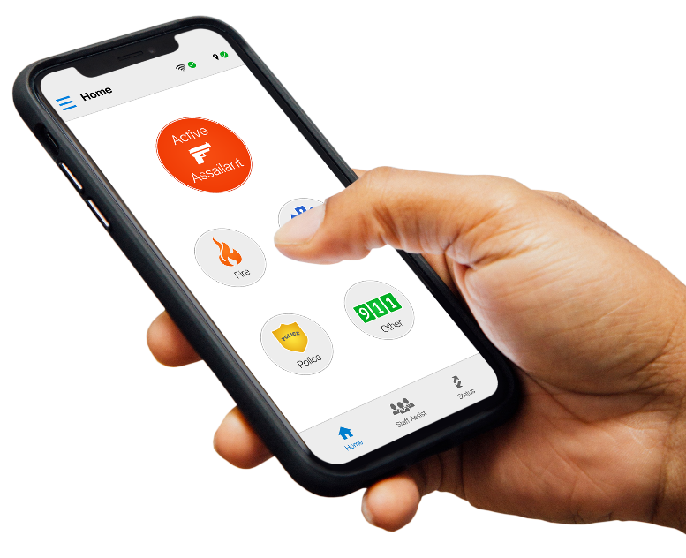
Louisiana Panic Button
Emergency Notification System
Rave Panic Button is offered free to all K-12 campuses and intended for administrators, faculty, and staff; not students. The App accelerates emergency response by placing a 911 call while simultaneously sending an In-App notification, Text message, and Email to school faculty & staff to become “immediate” responders until “first” responders arrive. The 911 centers receive critical incident information through RAVE Command View based on the schools profile.
69% of all public, private, and charter schools have opted into the statewide program.
52% of all public, private, and charter schools have trained their faculty and staff, deployed the application, and are live and operational.

Slide 118


Safe Schools Louisiana
Anonymous Reporting System
The Safe Schools Louisiana App is offered free to students in grades 6 through 12 statewide; public, private, and charter. The app allows students to share what they know with faculty, staff, counselors, and law enforcement, who can then prevent the preventable.
There have been 19,000 downloads of the application to date.
An average of 600 tips are submitted annual, just over 1,000 in 2023.
Currently, about 40% of all public, private, and charter schools within the qualifying grade groups have opted into the program.
A total of 2,284 tips have been processed since 2020 when the program began.

Slide 119
LCSS
Data Call Questionnaire
To ensure compliance with the School Safety Act and provide support in improving school safety programs, the Louisiana Center for Safe Schools at GOHSEP in collaboration with Louisiana State University conducted a statewide data call with all K-12 schools.
The Questionnaire includes the topics in compliance with the School Safety Act of 2023 such as security assessments, crisis plans, emergency notification platforms, anonymous reporting, district threat assessment teams, SROs and more. These details establish baseline data for future federal and state funding applications in school safety.
For additional questions, please contact us at safeschools@la.gov
Region | Total Schools | Count Finished | Percent Finished
Region 1 | 291 | 151 | 51.89%
Region 2 | 255 | 128 | 50.2%
Region 3 | 126 | 102 | 80.95%
Region 4 | 271 | 135 | 49.82%
Region 5 | 112 | 41 | 36.61%
Region 6 | 163 | 85 | 52.15%
Region 7 | 165 | 55 | 33.33%
Region 8 | 153 | 88 | 57.52%
Region 9 | 187 | 137 | 73.26%

Slide 120
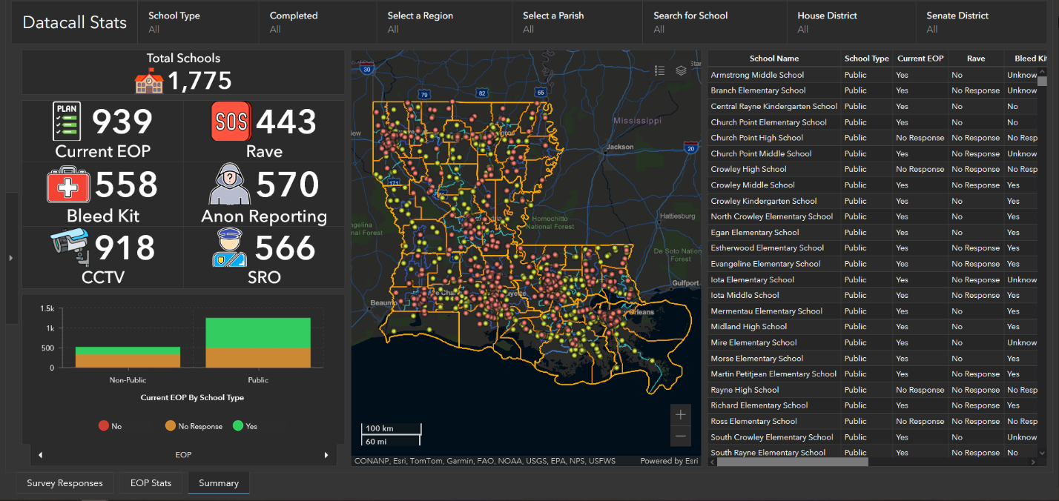
LCSS
School Safety Dashboards
March 2024 – Current – Statewide Data Call creates a baseline operating view in compliance with the legislative mandates and national best practices for each campus statewide.
March 2024 – Current – Creation of ESRI powered Dashboards displaying all schools, data call metrics, and other critical school safety information for solution expansion.

Slide 121

LCSS
School and Nonprofit Security Grant Program
The Fiscal Year Louisiana School and Nonprofit Security Grant Program (LSNSGP) (FY) 2024 is a -competitive, State-funded grant program for local school systems and non-profits to fund school safety and security-related projects. Authorized by the Louisiana Legislation to help strengthen Louisiana communities against potential acts of violence or other extremist attacks, priorities include: physical and security enhancements, enhancing the protection of soft targets/crowded places, effective planning; training and awareness campaigns; and exercises.
Available Funding FY24 LSNSGP | $5,000,000.00
Projected Number of Awards | Distribution by Regions, will vary.
Maximum Award Amount | $50,000.00

Slide 122

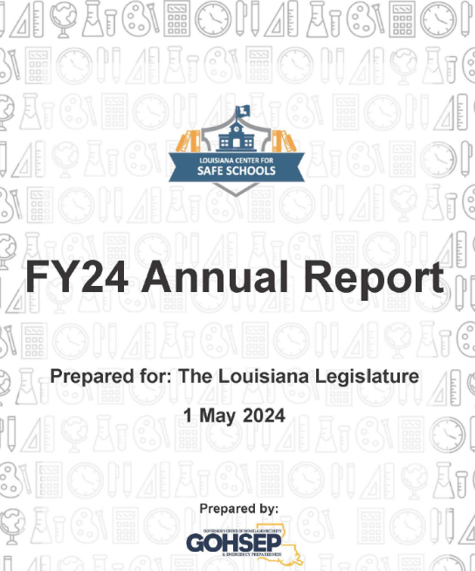
LCSS
School Safety Annual Report
Per Act 224 of 2023; P. 10, lines 4-8 (Paragraph C), “The center shall provide an annual report to the governor, the State Board of Elementary and Secondary Education, the Senate Committee on Education, and the House Committee on Education regarding the status of school safety in Louisiana, the work of the center and resources identified to increase school safety.”
LCSS is committed to continued growth and support to partner agencies and schools as we look into FY25. What has been achieved in the last quarter of FY24 is just the beginning. Creating safe learning environments require a collective effort at all levels of government and within the school systems, to include students, communities and families. By continuing to work together, committed to providing the resources needed, we will exceed mission requirements and make Louisiana schools a safe place for both educators and students.

Slide 123

LCSS
LEMC Post Conference Training
Post Conference Training – School Based Active Shooter Exercises May 9th
  Module 1: Prevention
  Module 2: Initial Response
  Module 3: Tactical Response
  Module 4: Evacuation and Reunification
  Module 5: Crisis Counseling
LCSS is committed to continued growth and support to partner agencies. Creating safe learning environments require a collective effort at all levels of government and within the school systems, to include students, communities and families. By continuing to work together, committed to providing the resources needed, we will exceed mission requirements and make Louisiana schools a safe place for both educators and students.

Slide 124
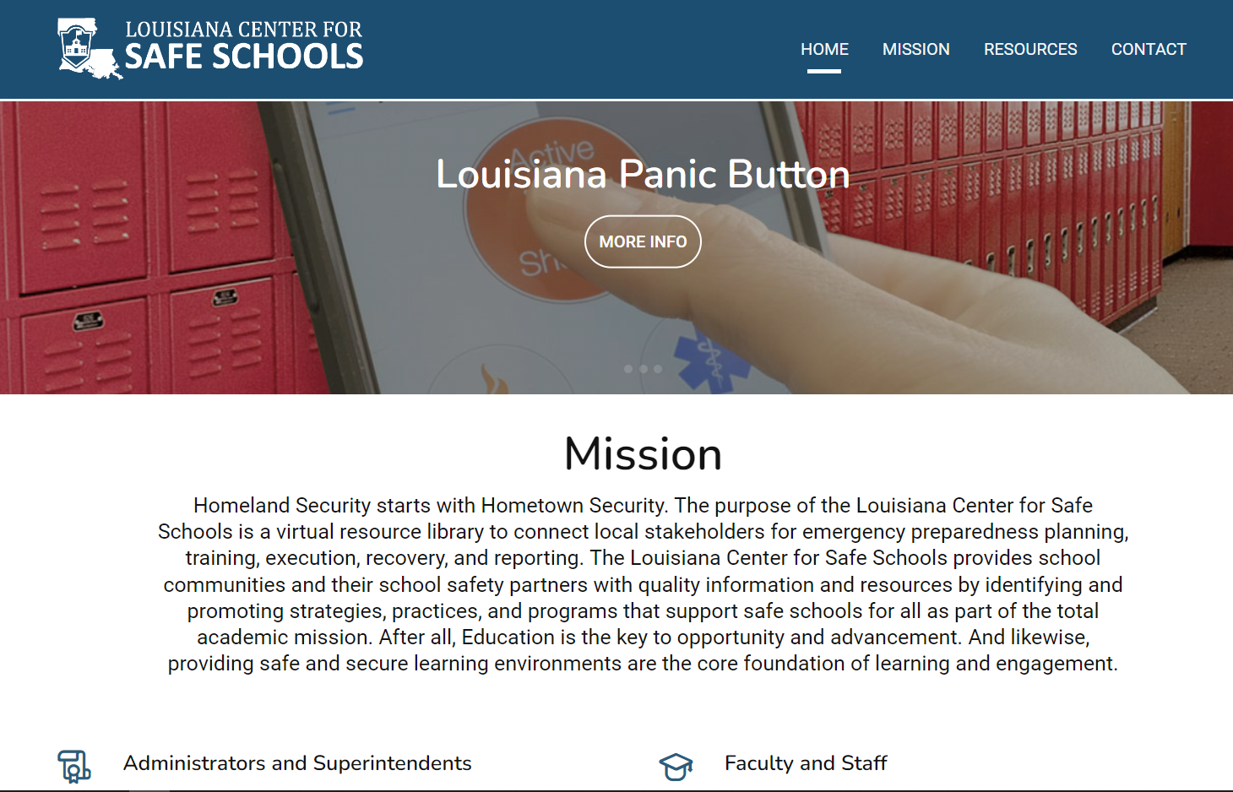
Louisiana Center for Safe Schools Website
  Administrators and Superintendents
  Parents and Students
  Faculty and Staff
  First Responders and Resource Officers
  Behavioral and Mental Health
  Louisiana Legislation
Website: https://lasafeschools.la.gov/

Slide 125
Cybersecurity Update
Matt Mckey

Slide 126
ESF-17 -> ESF-2 Cyber
ESF-17 is transitioning to ESF-2 Cyber
GOHSEP will replace OTS to Co-lead ESF-2 Cyber with LANG
12 full time cybersecurity positions in addition to the current 4 full time GOHSEP positions will transfer from OTS to GOHSEP to support ESF-2 Cyber and the Louisiana Cyber Assurance Program (LCAP)
No changes to services to local government entities impacted by cybersecurity attacks will result from this

Slide 127

LA Cyber Assurance Program
Developed to address State and Local cyber posture needs identified through ESF-17 responses 2019-2022
Approved and submitted with 2022 State and Local Cyber Grant Program (SLCGP) project as required by the Notice of Funding Opportunity
Tight application deadline allowed minimal time for local feedback on the plan
Projects
  Project 1: Assess and update the Louisiana Cybersecurity Assurance Plan
  Project 2: Establish the Cybersecurity Assessment Program
  Project 3: Establish the Cyber Threat Analytics Center
  Project 4: Deployment of Endpoint Detection and Response Software

Slide 128
LA Cyber Assurance Program
Cyber Assessment Program
  No Cost vulnerability assessments for State and Local Agencies
Cyber Threat Analytics Center
  24/7 monitoring, analysis, and response to cybersecurity threats, events, and incidents for State and Local Agencies
Deployment of Endpoint Detection and Response (EDR) Software
  One year EDR software license at no cost to State and Local Agencies

Slide 129
State Funding and Grant Opportunities
State of Louisiana has invested heavily in cybersecurity since 2019
  Proactive vs reactive spending approach
State and Local Cybersecurity Grant Program
  2022 – $3.6M (including 10% State cost share)
  2023 – $8.4M (including 20% State cost share)
  80% local pass through required
  25% rural pass through required
  All sub-recipient projects must be nested within the State’s plan (LCAP)

Slide 130
What To Do If Attacked
Report to LA-SAFE @ 1-800-434-8007
  To fulfill State and Federal reporting requirements
  To receive forensic analysis services from the LSP Cyber Crimes Unit
  To Receive access to State incident response resources through ESF-2 Cyber

Slide 131
Interoperability communications
Jacob Chatfield

Slide 132
ESF-2 Interoperability Communication Mission
When a large-scale critical incident strikes Louisiana, communications are often significantly affected, creating a daunting workload for the Statewide Interoperability Coordinator (SWIC)/Emergency Support Function #2 (ESF2) personnel. A major portion of this workload is coordinating the planning, response, and recovery phases from a communications perspective, including coordination with local, state, and federal government agencies as well as commercial communications entities.

Slide 133
Interoperability Communication Responsibilities
Emergency communications restoration
Coordination of Federal/State/Local communication resources
LWIN maintenance/restoration
Assisting local Parishes with direct communications to commercial carriers (Ex: Cell, Power, Fiber, Landlines, etc.)

Slide 134
Legal
Veronica Howard Sizer
Chief Executive Counsel
225-925-7541
Veronica.sizer2@la.gov
Jezreel Joseph Clayton Revere Jacquelyn Watts
General Counsels
gohseplegal@la.gov

Slide 135
Legal’s Responsibilities
Provide legal assistance to GOHSEP’s staff and management
Provide procurement and contracting technical assistance for subrecipients
Liaison to the U.S. Office of the Inspector General for auditing purposes.

Slide 136
Procurement for FEMA Grants
Improper procurement is the #1 reason nationally for FEMA deobligation.
FEMA – Monitors and enforces grant compliance, educates and informs, de-obligates and recoups money from noncompliant grantees
DHS, Office of Inspector General (OIG) – Provides oversight by auditing agencies, recipients, and sub-recipients
GOHSEP- Help sub-recipients and protect the State’s interest

Slide 137
Procurement for FEMA Grants
Improper procurement is the #1 reason nationally for FEMA deobligation.
FEMA – Monitors and enforces grant compliance, educates and informs, de-obligates and recoups money from noncompliant grantees
DHS, Office of Inspector General (OIG) – Provides oversight by auditing agencies, recipients, and sub-recipients
GOHSEP- Help sub-recipients and protect the State’s interest

Slide 138

Three Main Considerations for Procurement
FEMA Procurement Policies & Procedures
Using Proper Procurement Method
Using the Appropriate Contract

Slide 139
Proper Procurement Method
FEMA, like all other federal agencies, follows the procurement guidelines established in 2 C.F.R. §200.317-327.
Under these rules, State agencies and local governmental are generally allowed to follow their own procurement laws, rules, and guidelines. (2 C.F.R. §200.317) – Louisiana Procurement Code (La. R.S. §39:1551-1755) and Louisiana Public Bid Law (La. R.S. §38:2211, et seq.).
Know your local ordinances/policies for procurements.
FEMA’s main focus is to obtain reasonable costs through full and open competition.

Slide 140

Key Take Aways
Periodically check your procurement policies and procedures to ensure they comply with federal regulations.
Maintain records sufficient to detail the history of the procurement. These records will include, but are not limited to the following:
  Rationale for the method of procurement,
  Selection of contract type,
  Contractor selection or rejection, and
  The basis for the contract price.

Slide 141
Key Take Aways
Maintain oversight to ensure contractors perform according to the terms, conditions and specifications of their contracts or purchase orders.
Contact GOHSEPLEGAL@la.gov, should you need technical assistance with your procurement or other questions.

Slide 142
External Affair, Outreach, Education and More

Slide 143
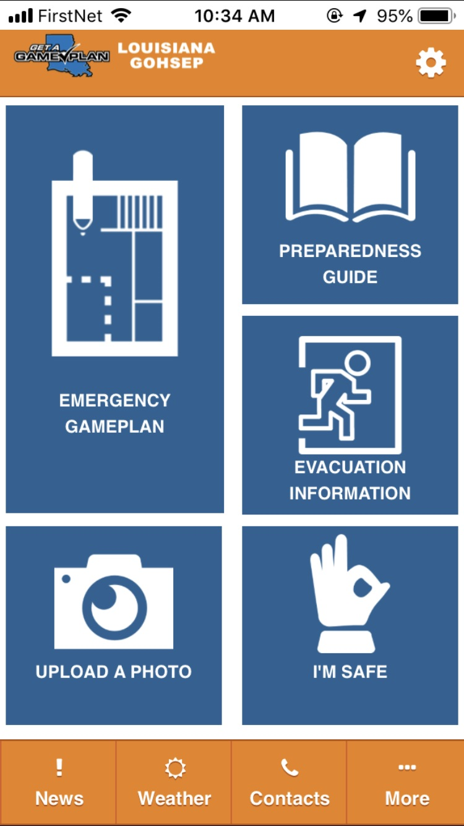

GOHSEP Preparedness App
Updated annually with new POCs

Slide 144

Public Relations / Media
The GOHSEP Get A Game Plan Podcast is live.
  Highlights emergency management issues at the local, State and Federal levels.

Slide 145
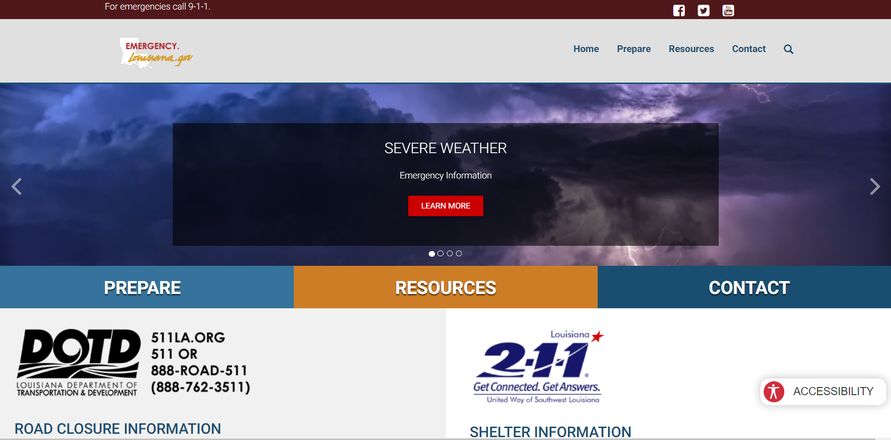

Emergency Public Information
emergency.la.gov

Slide 146
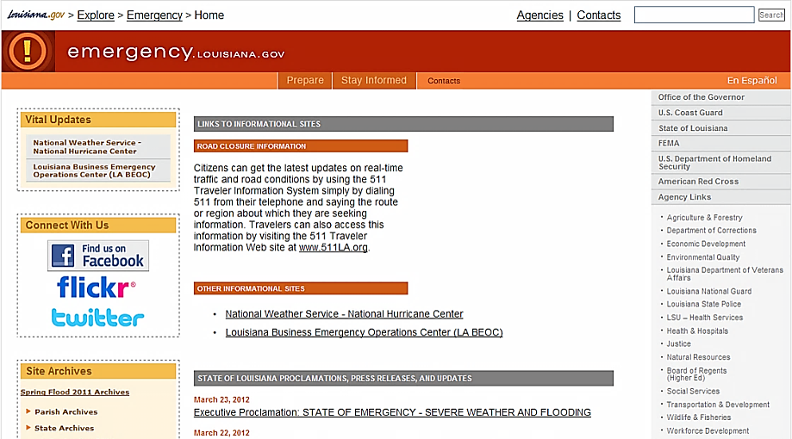
Emergency Public Information
emergency.la.gov

Slide 147
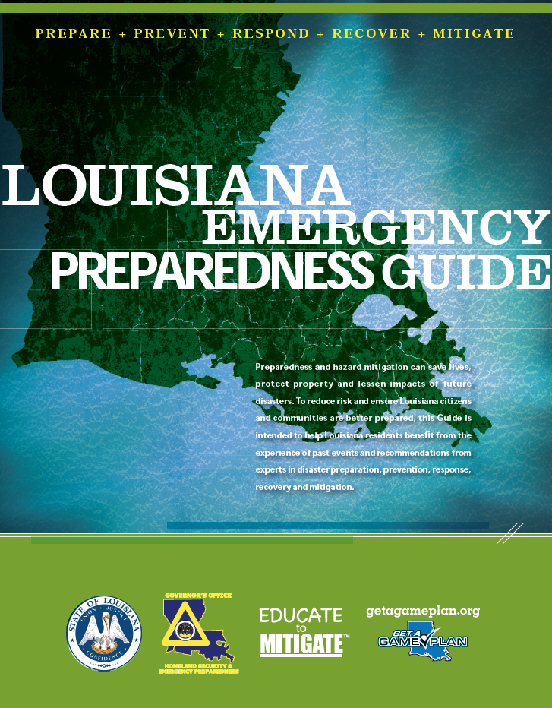

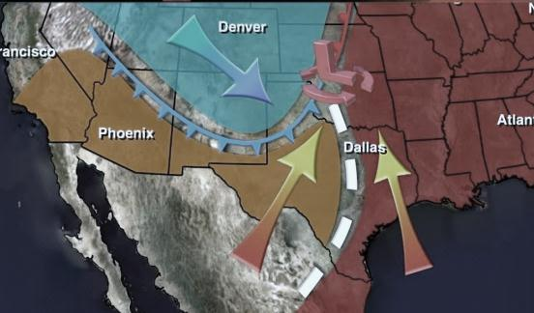


Emergency Public Information
Louisiana Emergency Preparedness Guides
The Louisiana Emergency Alert System (EAS) &
NOAA Weather Radio
EMERGENCY
Tornado
Warning
ALERT
SYSTEM
Baton
Rouge
A BROADCAST BY THE EMERGENCY ALERT SYSTEM

Slide 148



Louisiana Rave Alert/AT&T –
Resident Mass Communication Solution
  Transmit digital messages based
  on geographic or organizational groupings
  Messages delivered to a downloadable Apple or Google smartphone App
  App based emergency notifications for a user’s current geo-specific location & a single bookmarked location are free
  Integrates with National Weather Service – Tornado warnings etc.
  Residents opt in via
    SMS opt in, text keyword to short code

Slide 149
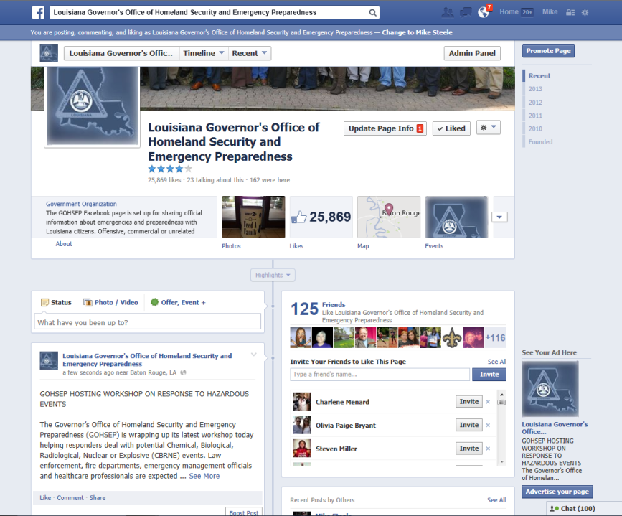
Social Media-Facebook

Slide 150

Social Media - Twitter
@GOHSEP

Slide 151




FIND US ON THE WEB
gohsep.la.gov
+
getagameplan.org

Slide 152
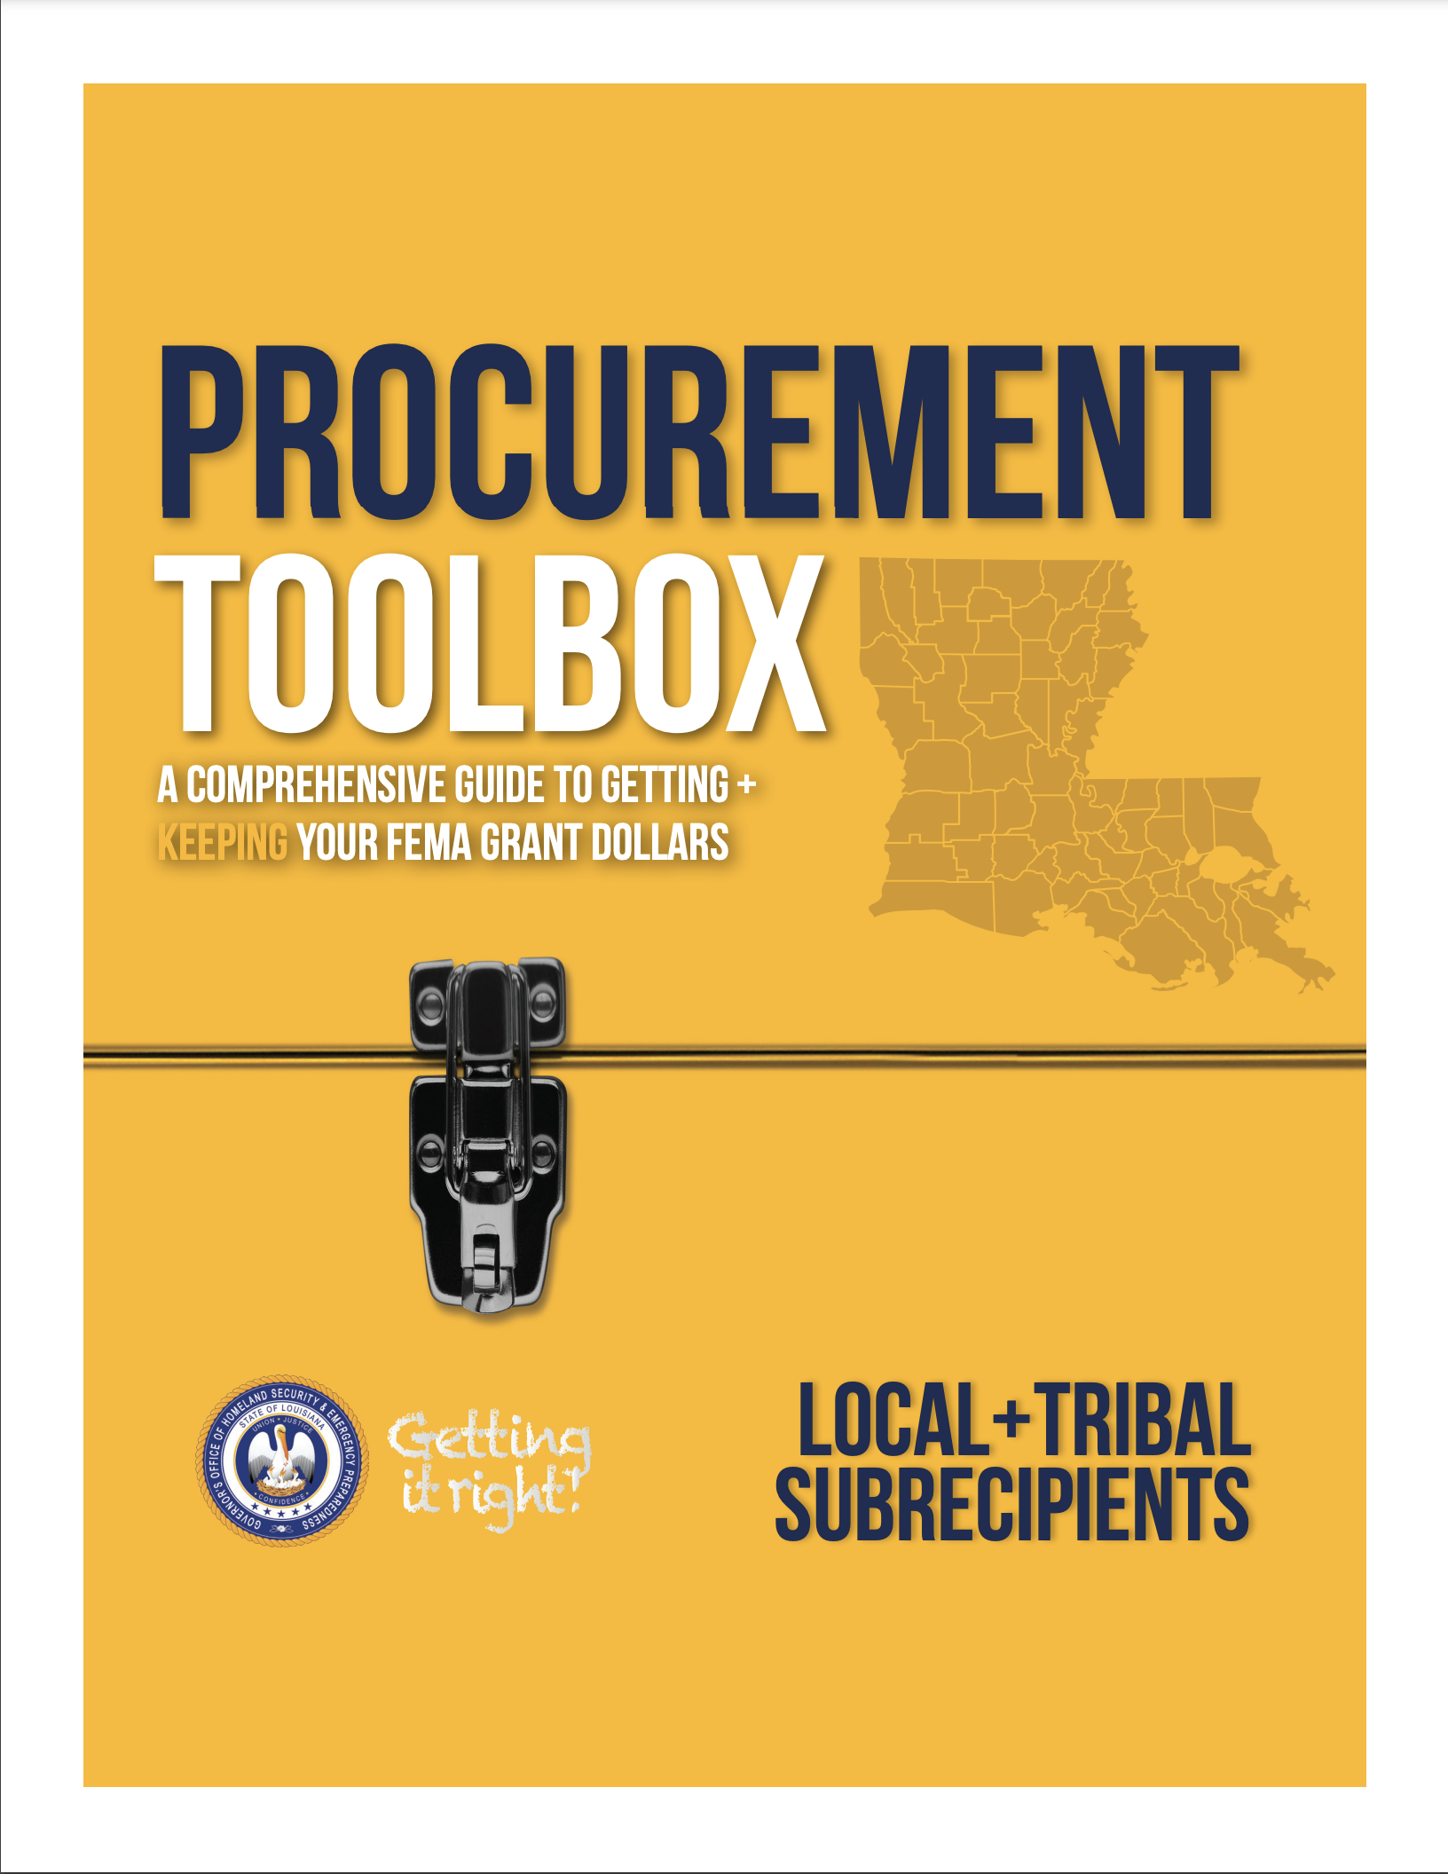



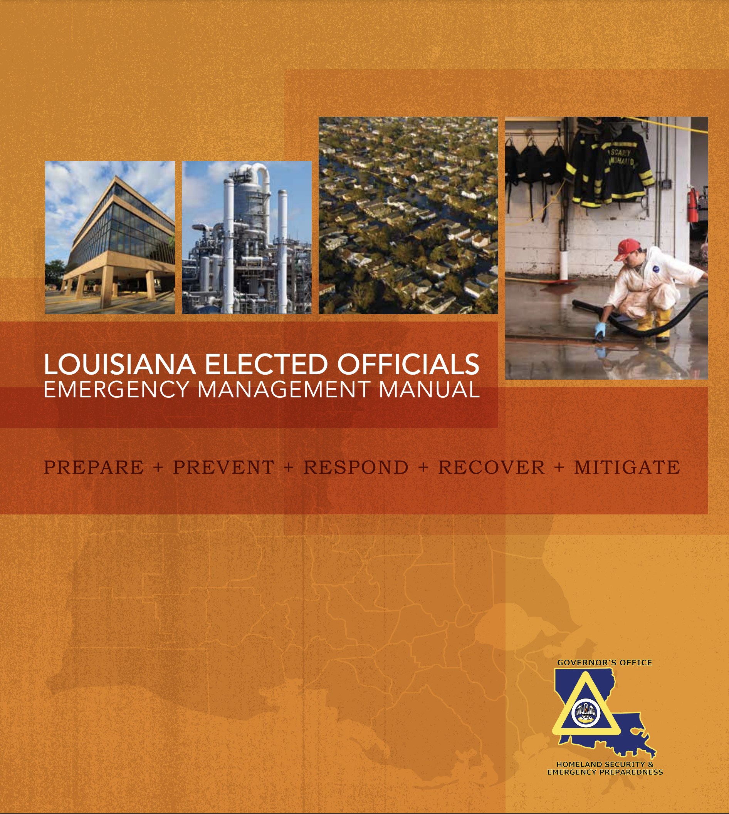
Resources
Click here to view Act 526
https://gohsep.la.gov/RESOURCES/OVERVIEW/PUBLICATIONS
Click here
Click here
Click here
Click here
Click here
62
Notes:
Today you are here as a trainee. When you complete today’s training, your role will become that as a field trainer. YOUR trainees will expect you to be very knowledgeable about your subject matter, even beyond that which is specifically addressed in the STAKEHOLDER ppt we are reviewing today.
We are looking to each of you to take on the responsibility of training and understand its importance to those we serve. The better we train, the more we know, the better we can serve the needs of the State and the needs of parishes, municipalities and tribal communities that face disasters or events that threaten the lives of their citizens and those who live in those communities.
We encourage you to not only learn the contents of the material you have been given today but to also learn more.
• Research GOHSEP’s website.
• Research FEMA’s website.
• Dig deeper.
• Become known as the expert we need you to be and the expert those vulnerable to disasters need you to be.
GOHSEP has a “library” of publications that can be found on the GOHSEP website (gohsep.la.gov). Under the MENU icon locate the RESOURCES tab. Click on RESOURCES then scroll to PUBLICATIONS tab. And of course, FEMA has a robust website as well.
Those publications noted on screen are several that we think you might find most helpful.

Slide 153
Questions?
Questions
63
Notes:
Having said all of that, we also recognize you may have questions. Now is a good time, so let’s spend the next few minutes to answer the questions you may have.
TAKE QUESTIONS
PRESENTER NOTE: Once Q & A is over, call for a 15-minute break.
When we get back from break, let your audience know the next and final segment of today’s training is to return to the Agenda Part 3 and talk about tools available that can help you be successful as a trainer.

